Slide 1
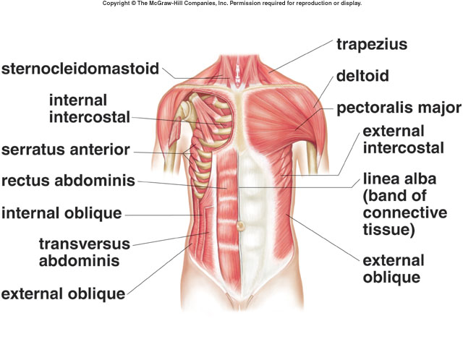
E. Muscles of the Trunk

Slide 2
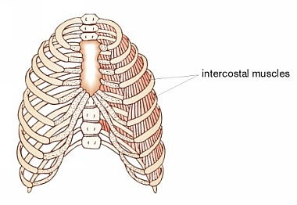
1. Muscles of the Thoracic Wall
a. intercostals (external/internal)
* L: between ribs
* A: elevate/depress rib cage (breathing)

Slide 3
External Intercostal
Origin: Inferior border of rib above
Insertion: Superior border of rib below
Action: Elevates rib cage during inspiration

Slide 4
Internal Intercostal
Origin: Superior border of rib below
Insertion: Inferior border of rib above
Action: Depresses rib cage during expiration

Slide 5
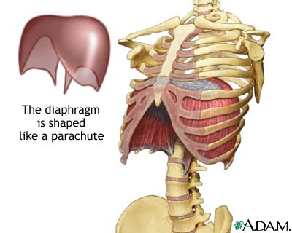
b. diaphragm
* L: separates thoracic/abdominal cavities
* A: breathing in

Slide 6
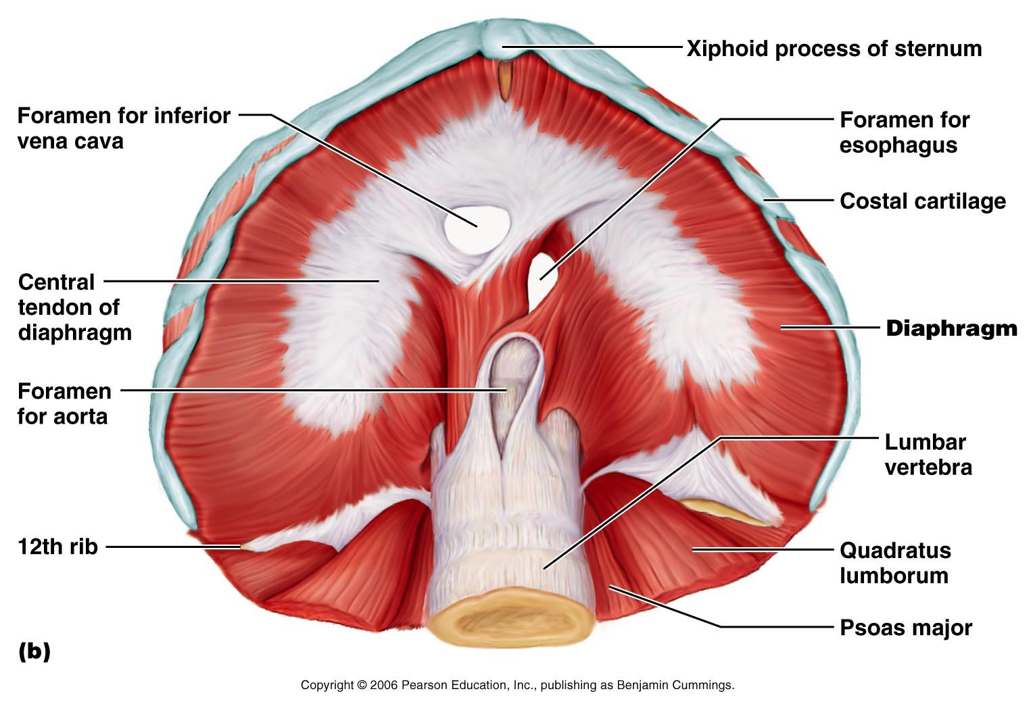
Muscles of Respiration: The Diaphragm
Diaphragm – most important muscle in inspiration

Slide 7
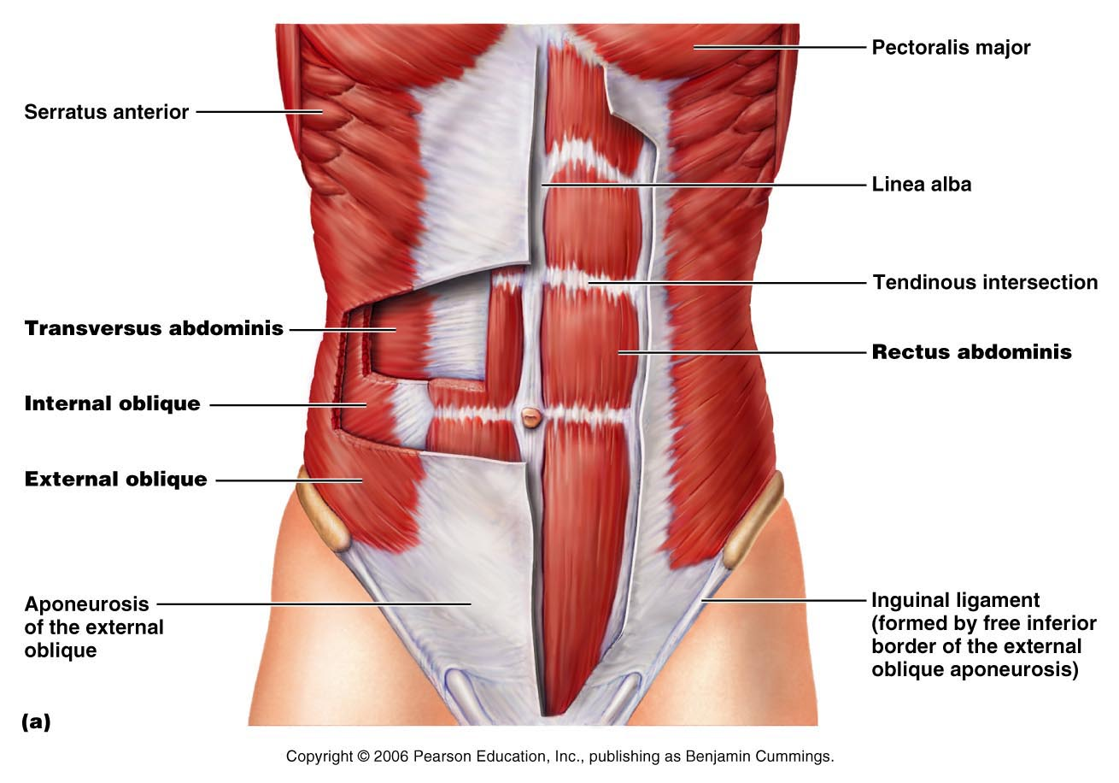
2. Muscles of the Abdominal Wall

Slide 8
a. external and internal obliques
* L: lateral abdominal wall (slanted)
* A: lateral rotation of trunk

Slide 9
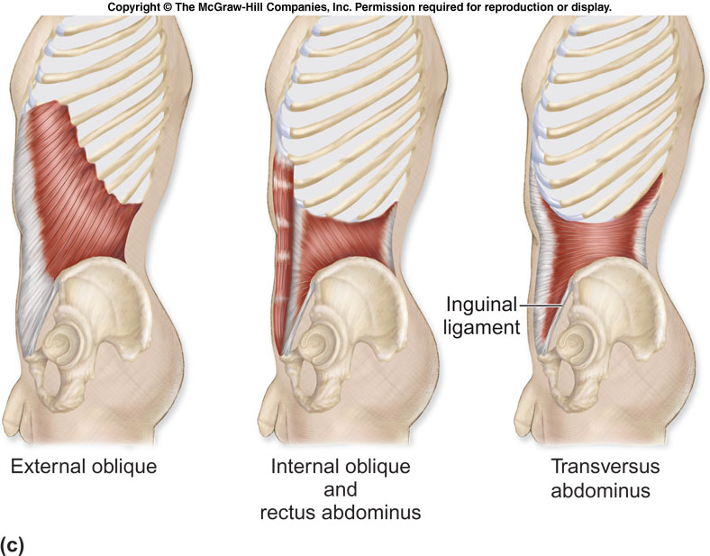

Slide 10
External Abdominal Oblique
Origin: External surface of lower 8 ribs
Insertion: Anterior half of iliac crest and linea alba
Action: Compresses abdomen, contralaterally rotates and flexes vertebral column

Slide 11
Internal Abdominal Oblique
Origin: Lateral half of inguinal ligament, anterior iliac crest and thoracolumbar fascia
Insertion: Lower four ribs, linea alba and by conjoined tendon to pubis
Action: Compresses abdomen, ipsilaterally rotates and flexes vertebral column

Slide 12
b. transverse abdominis
* L: deep abdomen
* A: tenses abdominal wall

Slide 13
Transverse Abdominis
Origin: Lateral third of inguinal ligament, anterior iliac crest, and thoracolumbar fascia
Insertion: Linea alba, and by conjoined tendon to pubis
Action: Compresses abdomen

Slide 15
c. rectus abdominis
* L: anterior abdomen
* A: flexes/rotates vertebral column

Slide 16
Rectus Abdominus
Origin: Pubic symphysis and crest of pubis
Insertion: Xiphoid process and cartilages of ribs 5 to 7
Action: Tenses abdominal wall and flexes vertebral column

Slide 17
F. Muscles of the Shoulder

Slide 18
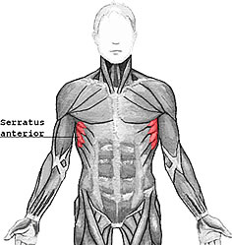
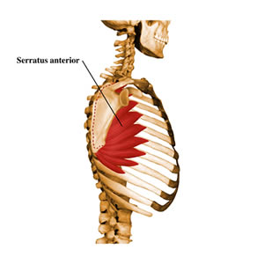
1. Muscles that Move the Scapula
a. serratus anterior
* L: upper lateral chest
* A: depresses scapula/pulls forward

Slide 19
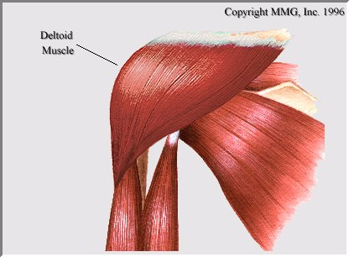
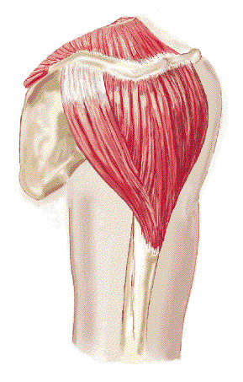
2. Muscles That Move the Humerus
a. deltoid
* L: lateral shoulder
* A: abducts humerus
Deltoid

Slide 20
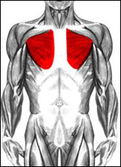
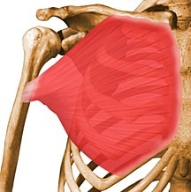
b. pectoralis major
* L: upper chest
* A: flexes/adducts humerus

Slide 21
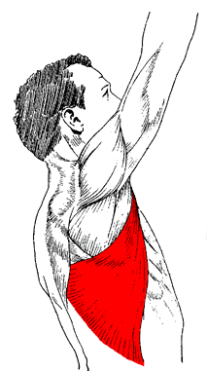
c. latissimus dorsi
* L: lateral back
* A: extends/adducts humerus

Slide 22
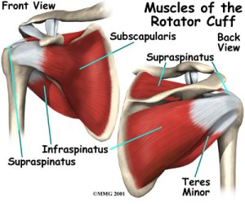
d. rotator cuff
* L: posterior shoulder
* A: stabilizes shoulder, rotates humerus

Slide 23
Shoulder Stability
Rotator cuff (four tendons) that encircles the shoulder joint and blends with the articular capsule
Rotator cuff muscles – supraspinatus, infraspinatus, teres minor, and subscapularis

Slide 24
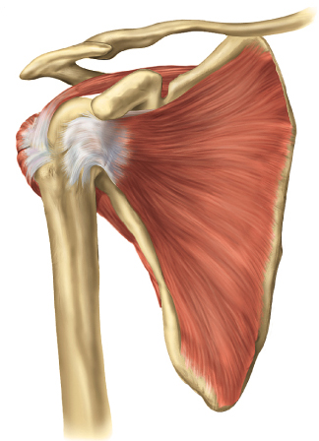
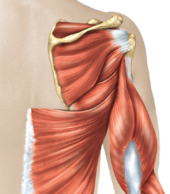
Rotator Cuff Muscles
Extending from posterior scapula to humerus
supraspinatus
infraspinatus
teres Minor
Subscapularis
Supraspinatus
Infraspinatus
Extending from anterior scapula to humerus
subscapularis
Teres minor
All 4 help reinforce joint capsule.

