Slide 1
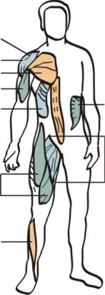
Muscles students need to know:
Rotator Cuff
Deltoid (delts)
Pectorals (pecs)
Biceps
External Obliques (waist)
Quadriceps (quads)
Tibialis Anterior (shins)
Internal Obliques (waist)
Adductors (inner thighs)

Slide 2
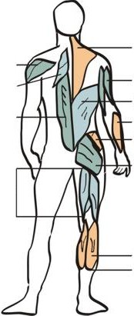
Deltoid (delts)
Rhomboids
Erector Spinae (lower back)
Hamstrings (hams)
Trapezius (traps)
Triceps
Latissimus Dorsi (lats)
Forearm
Gluteus Medius (outer thigh)
Gluteus Maximus (glutes)
Gastonemius (calves)
Soleus (calves)

Slide 3
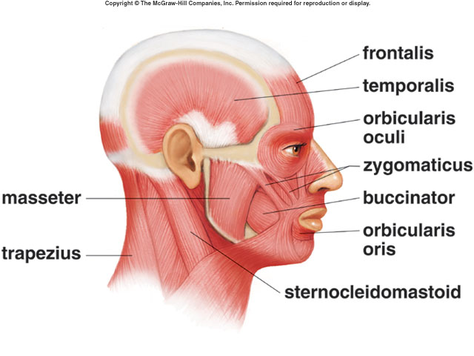
C. Muscles of the Head
1 . Muscles of Facial Expression

Slide 4
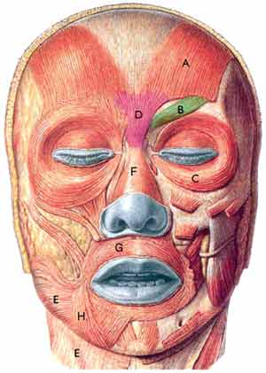
a. frontalis
* L: forehead
* A: elevates eyebrows/wrinkles brow

Slide 5
Frontalis
Epicranial Aponeurosis
Origin: Epicranial aponeurosis
Insertion: Skin over forehead
Action: Elevates eyebrows and wrinkles skin of forehead

Slide 6
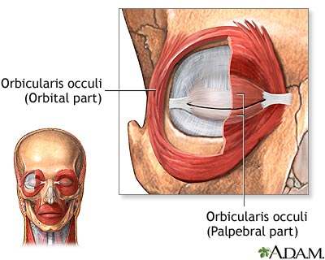
b. orbicularis oculi
* L: circles the eye
* A: closes eye

Slide 7
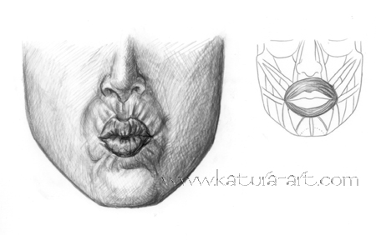
c. orbicularis oris
* L: circles mouth
* A: closes/puckers lips “kiss”

Slide 8
Orbicularis Oris
Origin: By muscular skips to surround muscles
Insertion: Muscles interlace to surround mouth
Action: Closes and purses lips

Slide 9
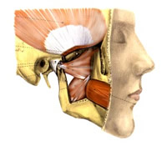
d. buccinator
* L: cheek
* A: compresses cheek “trumpeter’s muscle”

Slide 10
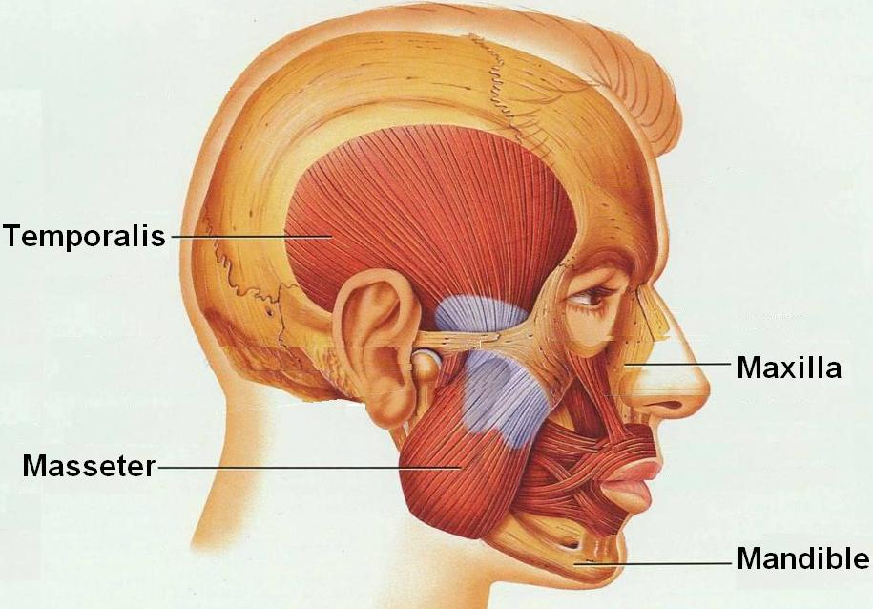
e. zygomaticus
* L: cheek mouth
* A: raises corner of mouth “smiling muscle”

Slide 11
2. Muscles of Mastication (Chewing)
a. masseter
* L: jaw
* A: elevates mandible (closes jaw)

Slide 12
Masseter
Origin: Zygomatic process and arch
Insertion: Angle and ramus of mandible
Action: Elevates mandible

Slide 13
b. temporalis
* L: temporal region
* A: elevates mandible (closes jaw)

Slide 14
Temporalis
Origin: Temporal fossa
Insertion: Coronoid process of mandible
Action: Elevates and retracts mandible

Slide 15
Muscles of Mastication

Slide 16
D. Muscles of the Neck

Slide 17
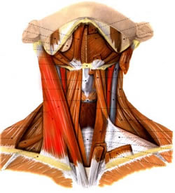
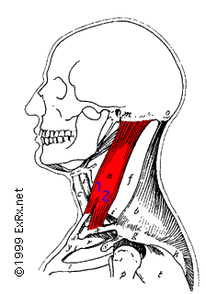
1. Muscles that Move the Head
a. sternocleidomastoid
* L: anterior lateral neck
* A: rotates head (1), flexes neck (2)

Slide 18
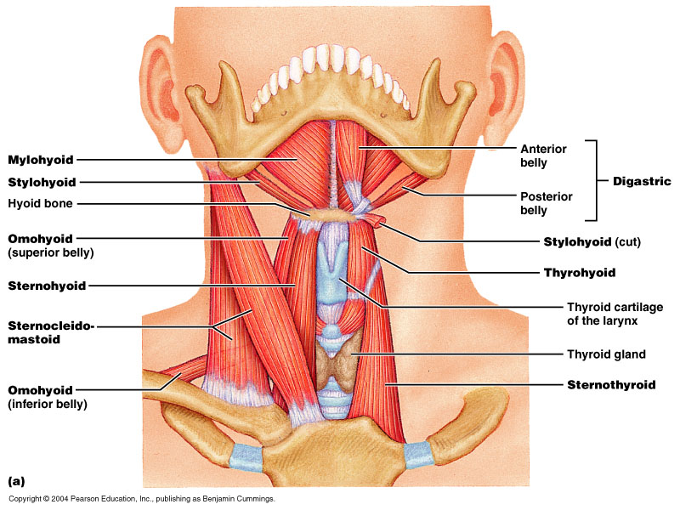
Muscles of the Anterior Neck and Throat: Suprahyoid

Slide 19
Sternocleidomastoid
Origin: Manubrium and medial third of clavicle
Insertion: Mastoid process
Action: Rotates head to opposite side, extends head, and flexes vertebral column

Slide 20
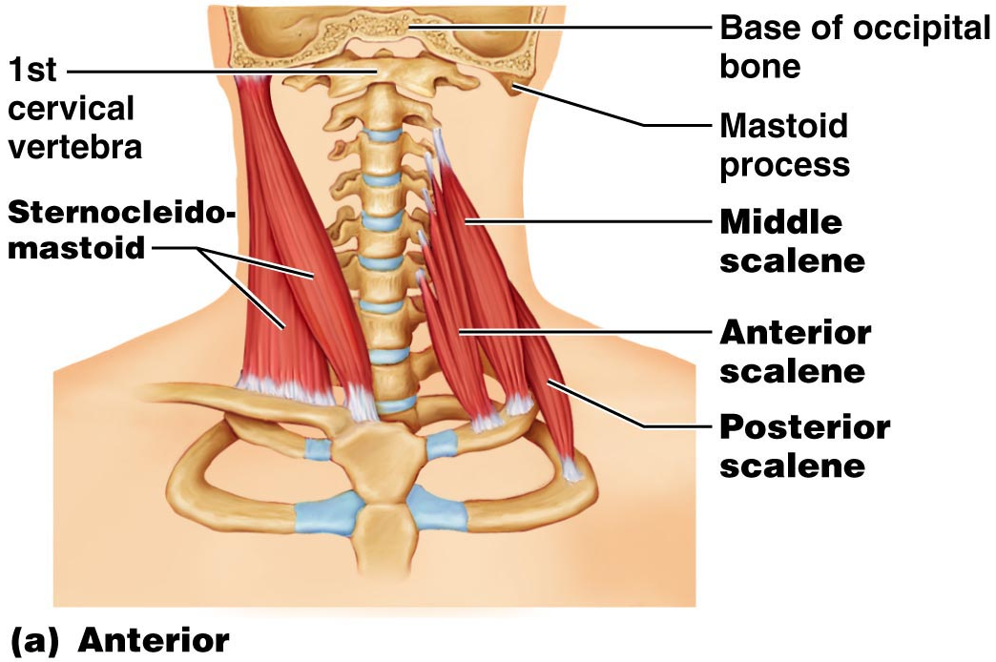
Muscles of the Neck: Head Movements
Figure 10.9a

Slide 21
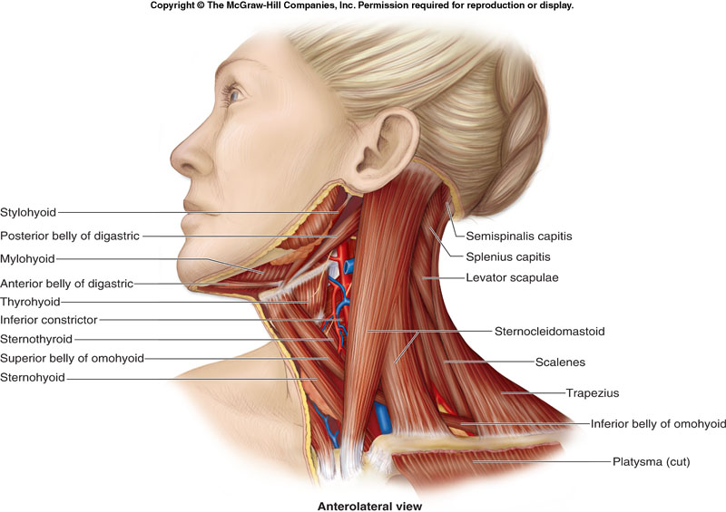

Slide 22
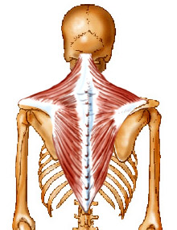
b. trapezius
* L: posterior neck/upper back
* A: extends head, adducts/elevates scapula

Slide 23
Trapezius
Origin: External occipital protuberance, superior nuchal line and spinous process of C₇-T₁₂
Insertion: Anterior border of scapular spine, acromion process, lateral third of clavicle
Action: Elevates, adducts, and depresses scapula

Slide 24
