Slide 1
G. Muscles of the Arm
* move the forearm (elbow)

Slide 2
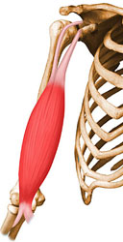
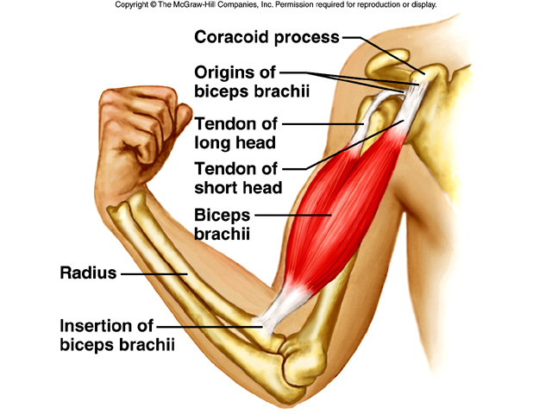
1. biceps brachii
* L: anterior upper arm
* A: flexes elbow, supinates hand

Slide 3
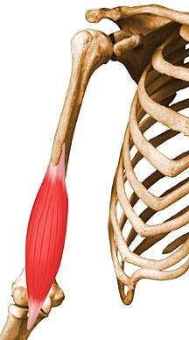
2. brachialis
* L: medial upper arm
* A: flexes elbow

Slide 4
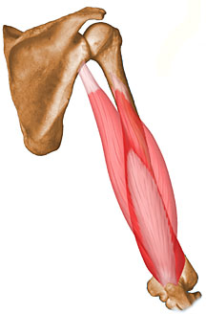
3. triceps brachii
* L: posterior upper arm
* A: extends elbow

Slide 5
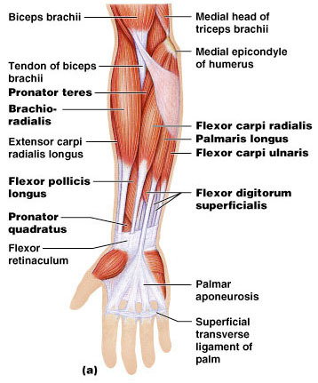
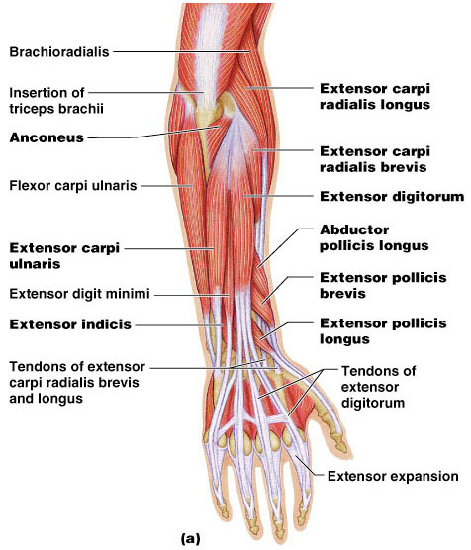
H. Muscles of the Forearm
* move the hand (wrist) and fingers

Slide 6
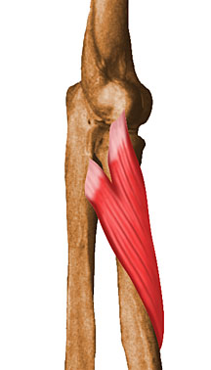
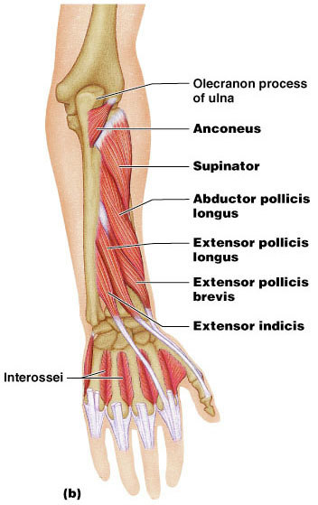
1. supinator
* L: anterior/medial forearm
* A: supinates hand

Slide 7
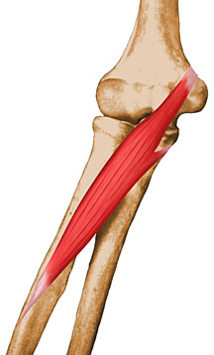
2. pronator teres
* L: anterior/upper forearm
* A: pronates hand

Slide 8
3. flexor/extensor carpi muscles
* L: forearm
* A: flex/extend wrist

Slide 9
4. flexor/extensor digitorum muscles
* L: forearm
* A: flex/extend fingers

Slide 10
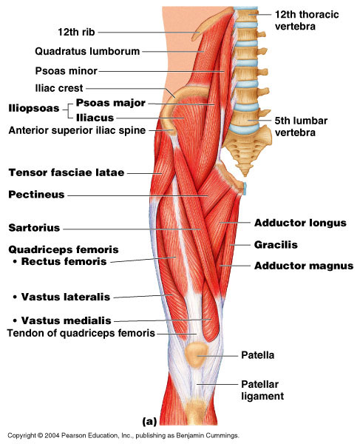
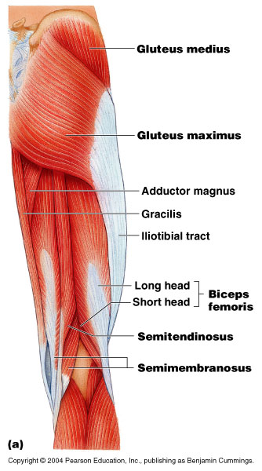
I. Muscles that move the Hip and Lower limb

Slide 11
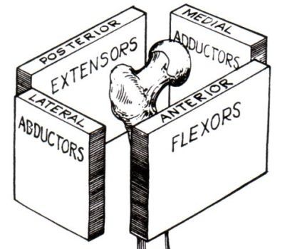
1. Muscles That Move the Hip (Femur)

Slide 12
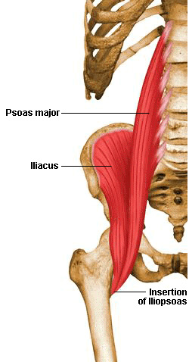
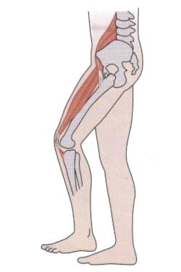
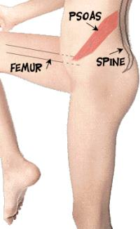
a. iliopsoas
* L: deep anterior hip
* A: flexes hip

Slide 13
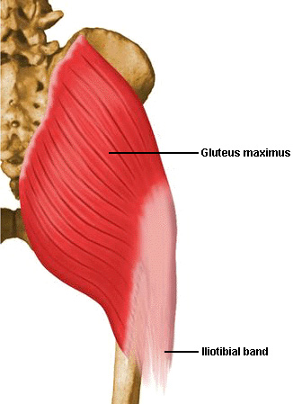
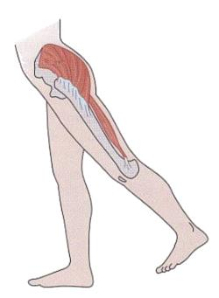
b. gluteus maximus
* L: posterior hip
* A: extends hip

Slide 14
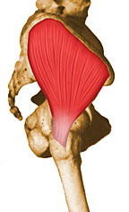
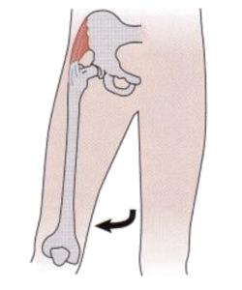
c. gluteus medius
* L: lateral hip
* A: abducts hip

Slide 15
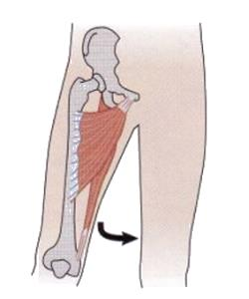
d. adductor group (groin)
* L: medial thigh
* A: adducts hip

Slide 16
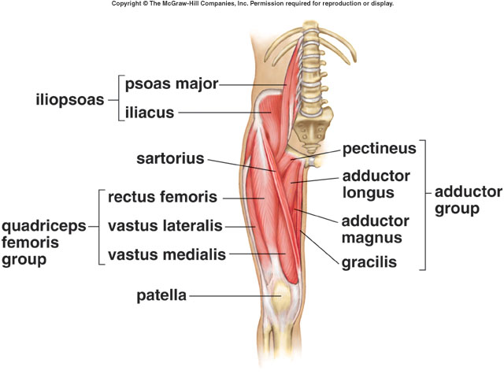

Slide 17
e. sartorius
* L: crosses front of thigh
* A: flexes, abducts, rotates hip

Slide 18
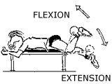
2. Muscles that move the Knee

Slide 19
a. quadriceps femoris group
* L: anterior thigh
* A: extends knee
vastus lateralis
vastus medialis
vastus intermedius
rectus femoris

Slide 21
b. hamstring group
* L: posterior thigh
* A: flexes knee, extends hip
semitendinosus
semimembranosus
biceps femoris

Slide 22
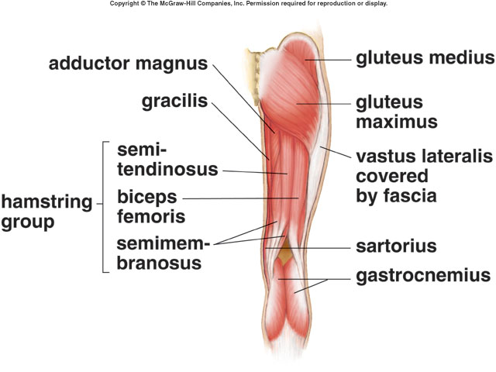

Slide 23
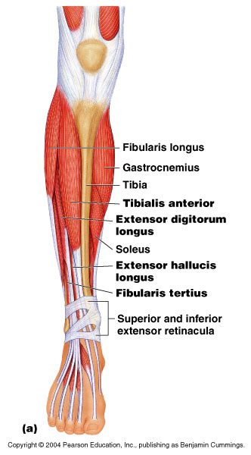
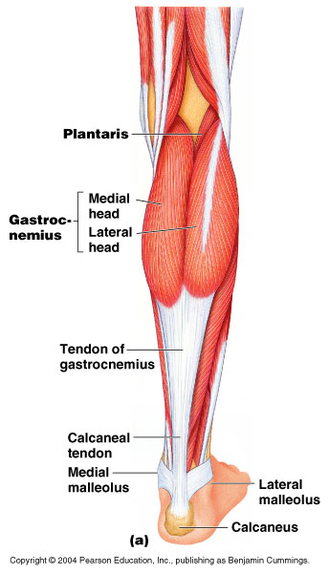
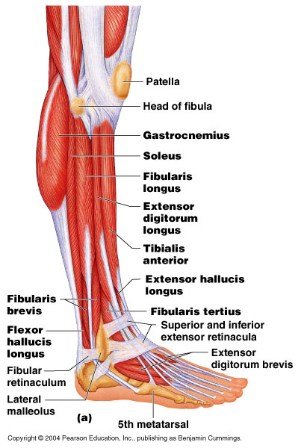
3. Muscles that Move the Ankle and Toes

Slide 24
a. gastrocnemius
* L: posterior lower leg (calf)
* A: plantar flexes, everts ankle

Slide 25
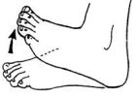
b. tibialis anterior
* L: anterior lower leg (shin)
* A: dorsiflexes, inverts foot

Slide 26
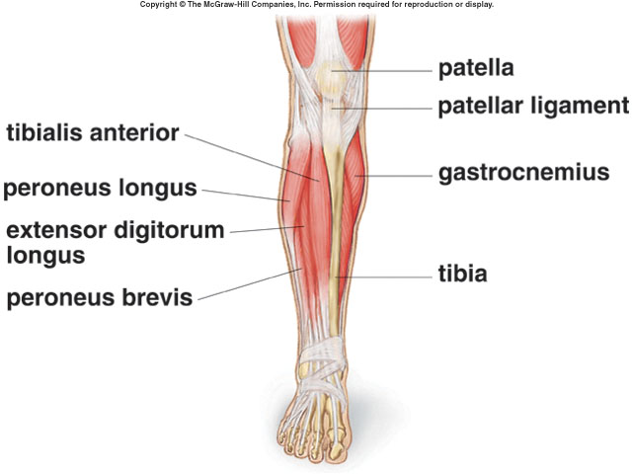
c. peroneus longus and brevis
* L: lateral lower leg
* A: evert, plantar flex foot

Slide 27
d. flexor/extensor digitorum longus
* L: lateral posterior lower leg
* A: flex/extend toes

