Slide 1
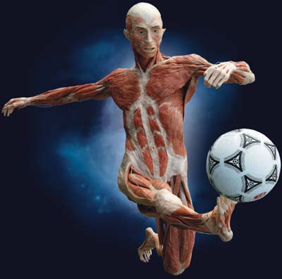
Chapter 7 The Muscular System

Slide 2
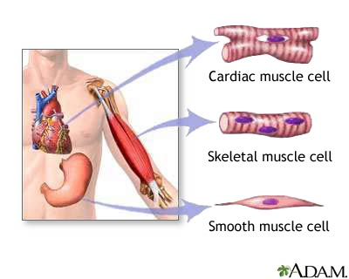
7.1 Functions and Types of Muscles

Slide 3
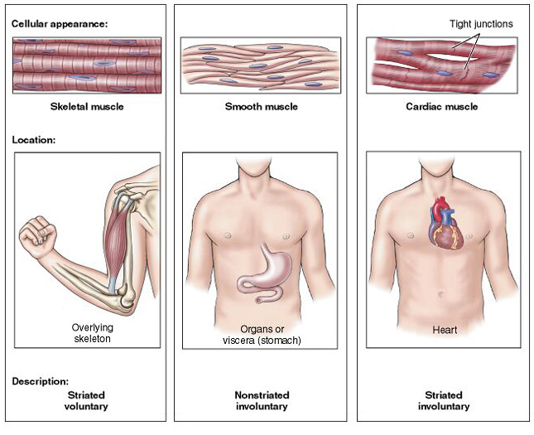
* 3 types of muscles:
smooth, cardiac, skeletal
*muscle cells are called muscle fibers

Slide 4
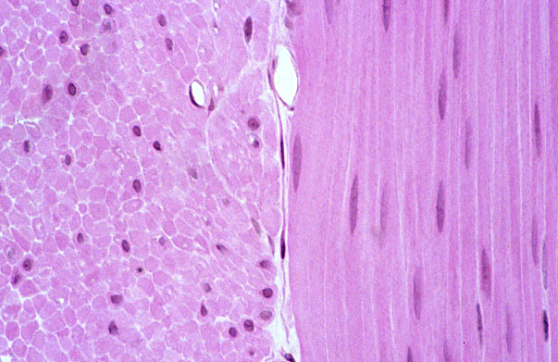
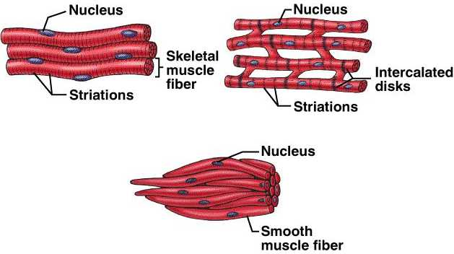
Smooth Muscle
* walls of organs
* involuntary
* spindle shaped
* uninucleated
* no striations
* slower, longer contractions

Slide 5
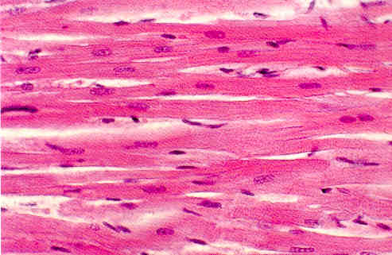
Cardiac Muscle
* heart wall
* involuntary
* tubular shaped & branched
* uninucleated
* striated
* relaxes between contractions

Slide 6
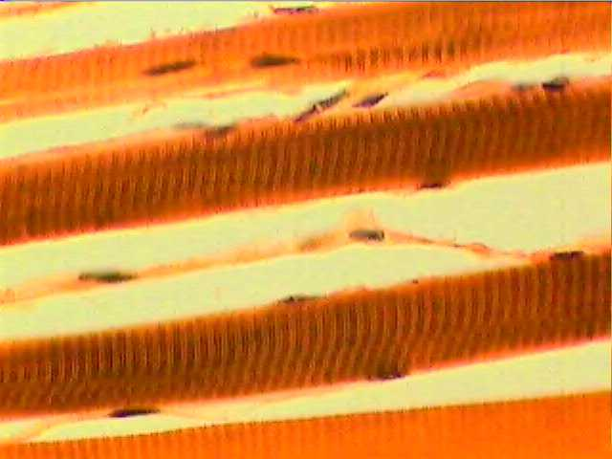
Skeletal Muscle
* skeletal muscles
* voluntary
* tubular shaped
* multinucleated
* striated

