Slide 1
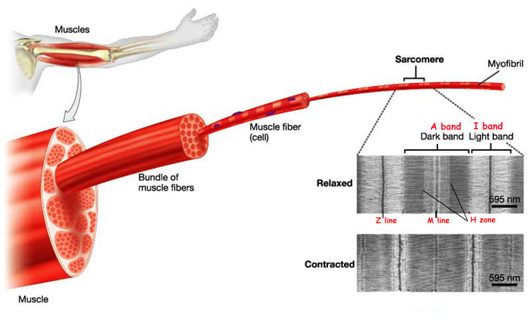
7.2 Microscopic Anatomy and Contraction of Skeletal Muscle
(fasicle)

Slide 2
A. Muscle Fiber

Slide 3
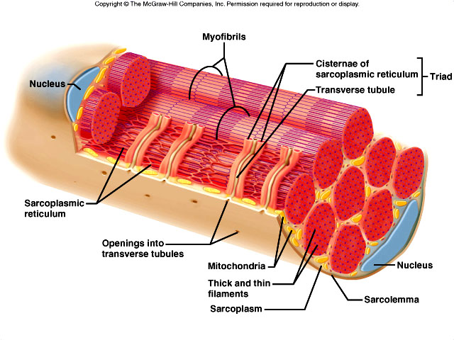
1. sarcolemma
* muscle cell membrane
* extends into muscle fiber (forms T-tubules)

Slide 4
2. sarcoplasmic reticulum (SR)
* has calcium (Ca²⁺) storage sites

Slide 5
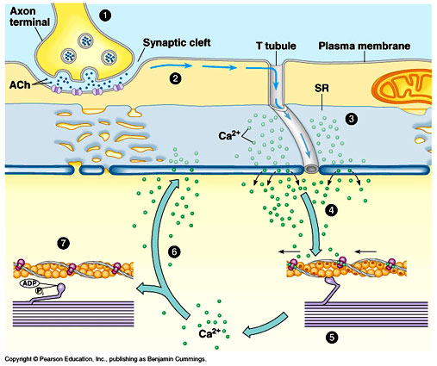

Slide 6
3. Myofibrils and Sarcomeres

Slide 7
a. myofibrils
* threadlike strands within muscle fibers
* composed of 2 types of myofilaments :

Slide 8
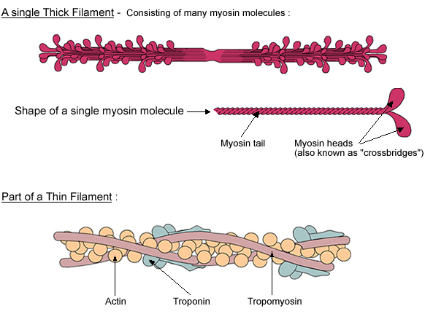
thick filaments
* composed of protein myosin
(shaped like a golf club - head/tail)

Slide 9
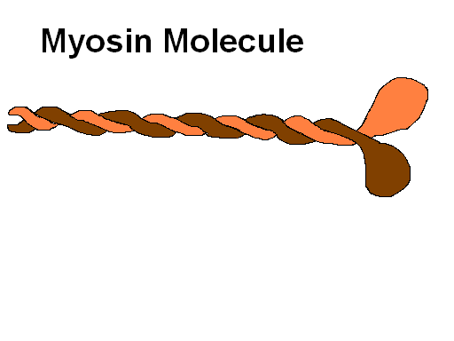

Slide 10
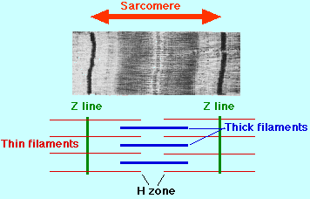

Slide 11
thin filaments
* 2 twisted strands of protein actin
(contains myosin binding site)

Slide 13
* other proteins:
tropomyosin –
long (wraps around actin)
covers the myosin binding sites

Slide 14
troponin –
smaller (bound to tropomyosin)
has calcium binding sites.

Slide 15
b. sarcomeres
* contractile sections of myofibril (striations)
* extend between 2 dark lines (Z lines)
Notes:
15

Slide 16
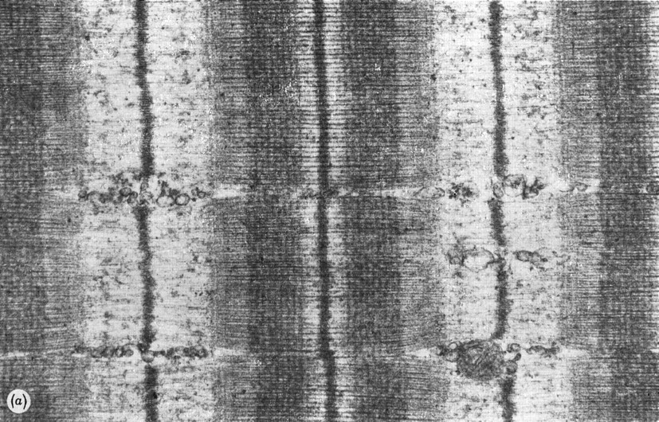

Slide 17
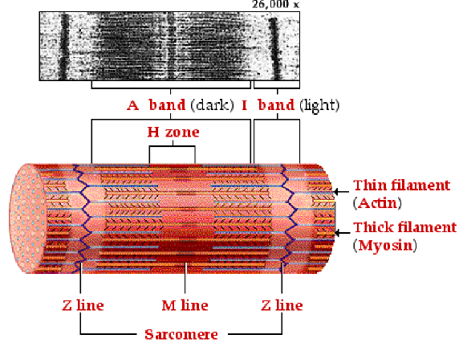

Slide 18
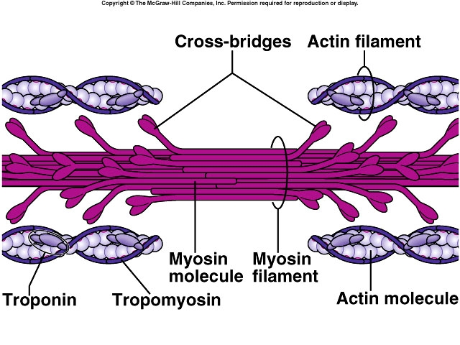

Slide 19
The Sarcomere
sarcomere
A band
H zone
Z disc
M line
I band
thick filament (myosin)
thin filament (actin)

Slide 20
“Sliding Filament” Mechanism
Contraction results from the sliding action of actin and myosin filaments
RELAXED:
CONTRACTED:

Slide 21
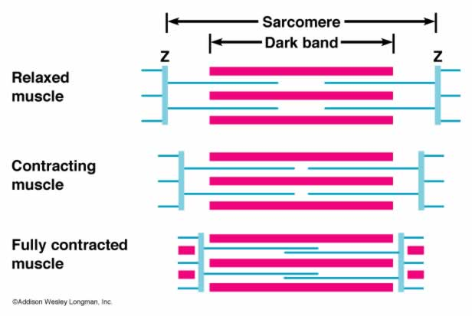
c. Sliding Filaments
* sarcomere shortens = contraction
* thin filaments slide past thick filaments:

Slide 22
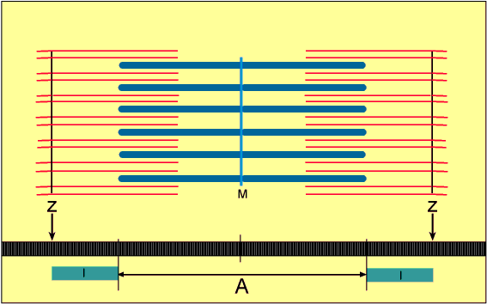
“sliding filament theory”

Slide 24
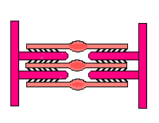

Slide 25
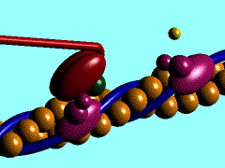

Slide 28
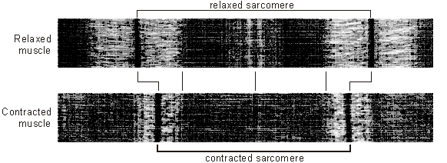

Slide 30
muscle (epimysium)
fascicle (perimysium)
muscle fiber (endomysium)
myofibril (sarcomeres)
myofilaments (thick & thin)

