Slide 1
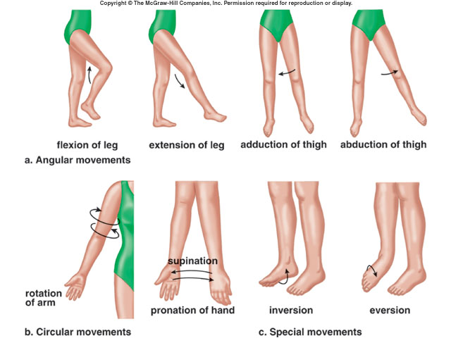
Body Movements
* kinesiology = the study of movement
Notes:
1
1

Slide 2
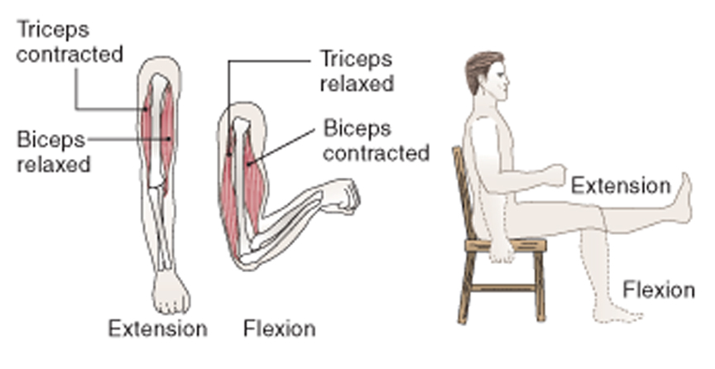
1. Angular Movements
* flexion : decreases joint angle “bend”
* extension : increases joint angle “straighten”
(hyperextension = beyond 180º)
Notes:
2
2

Slide 3
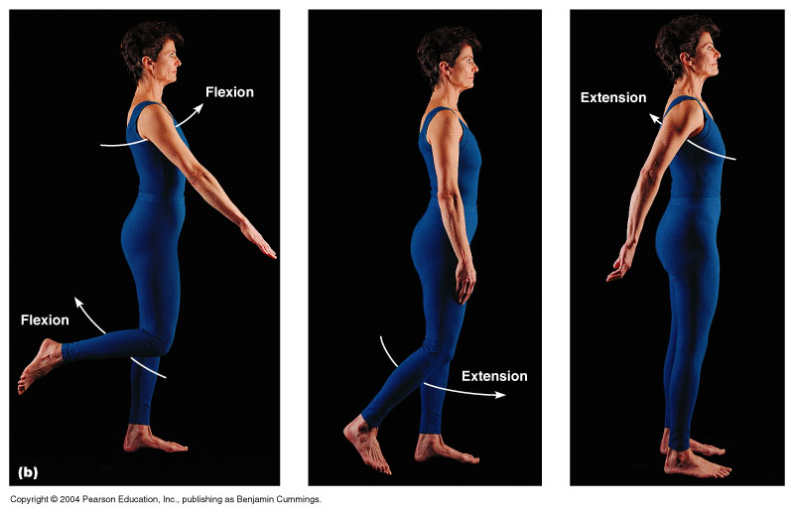

Slide 4
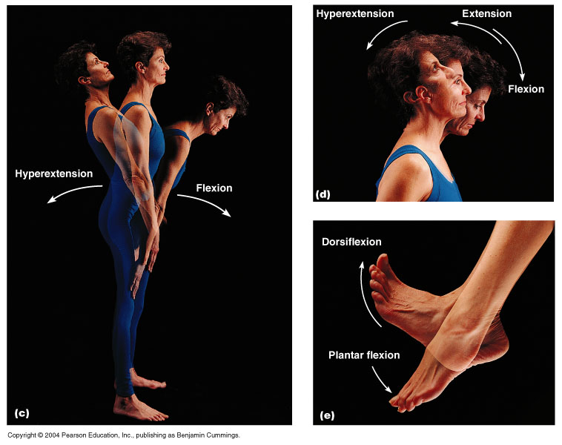

Slide 5
* plantar flexion : extension of ankle (point toes)
* dorsiflexion : flexion of ankle (toes up)
Notes:
5
5

Slide 6
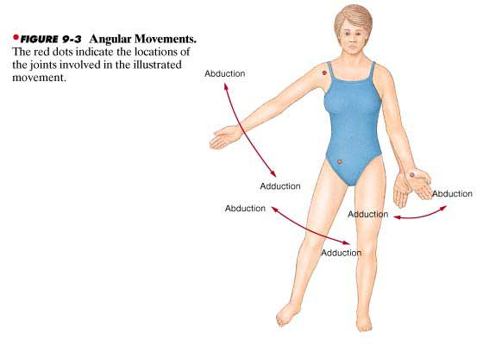
* abduction : away from the midline (arm/leg)
* adduction : toward the midline (arm/leg)
Notes:
6
6

Slide 7
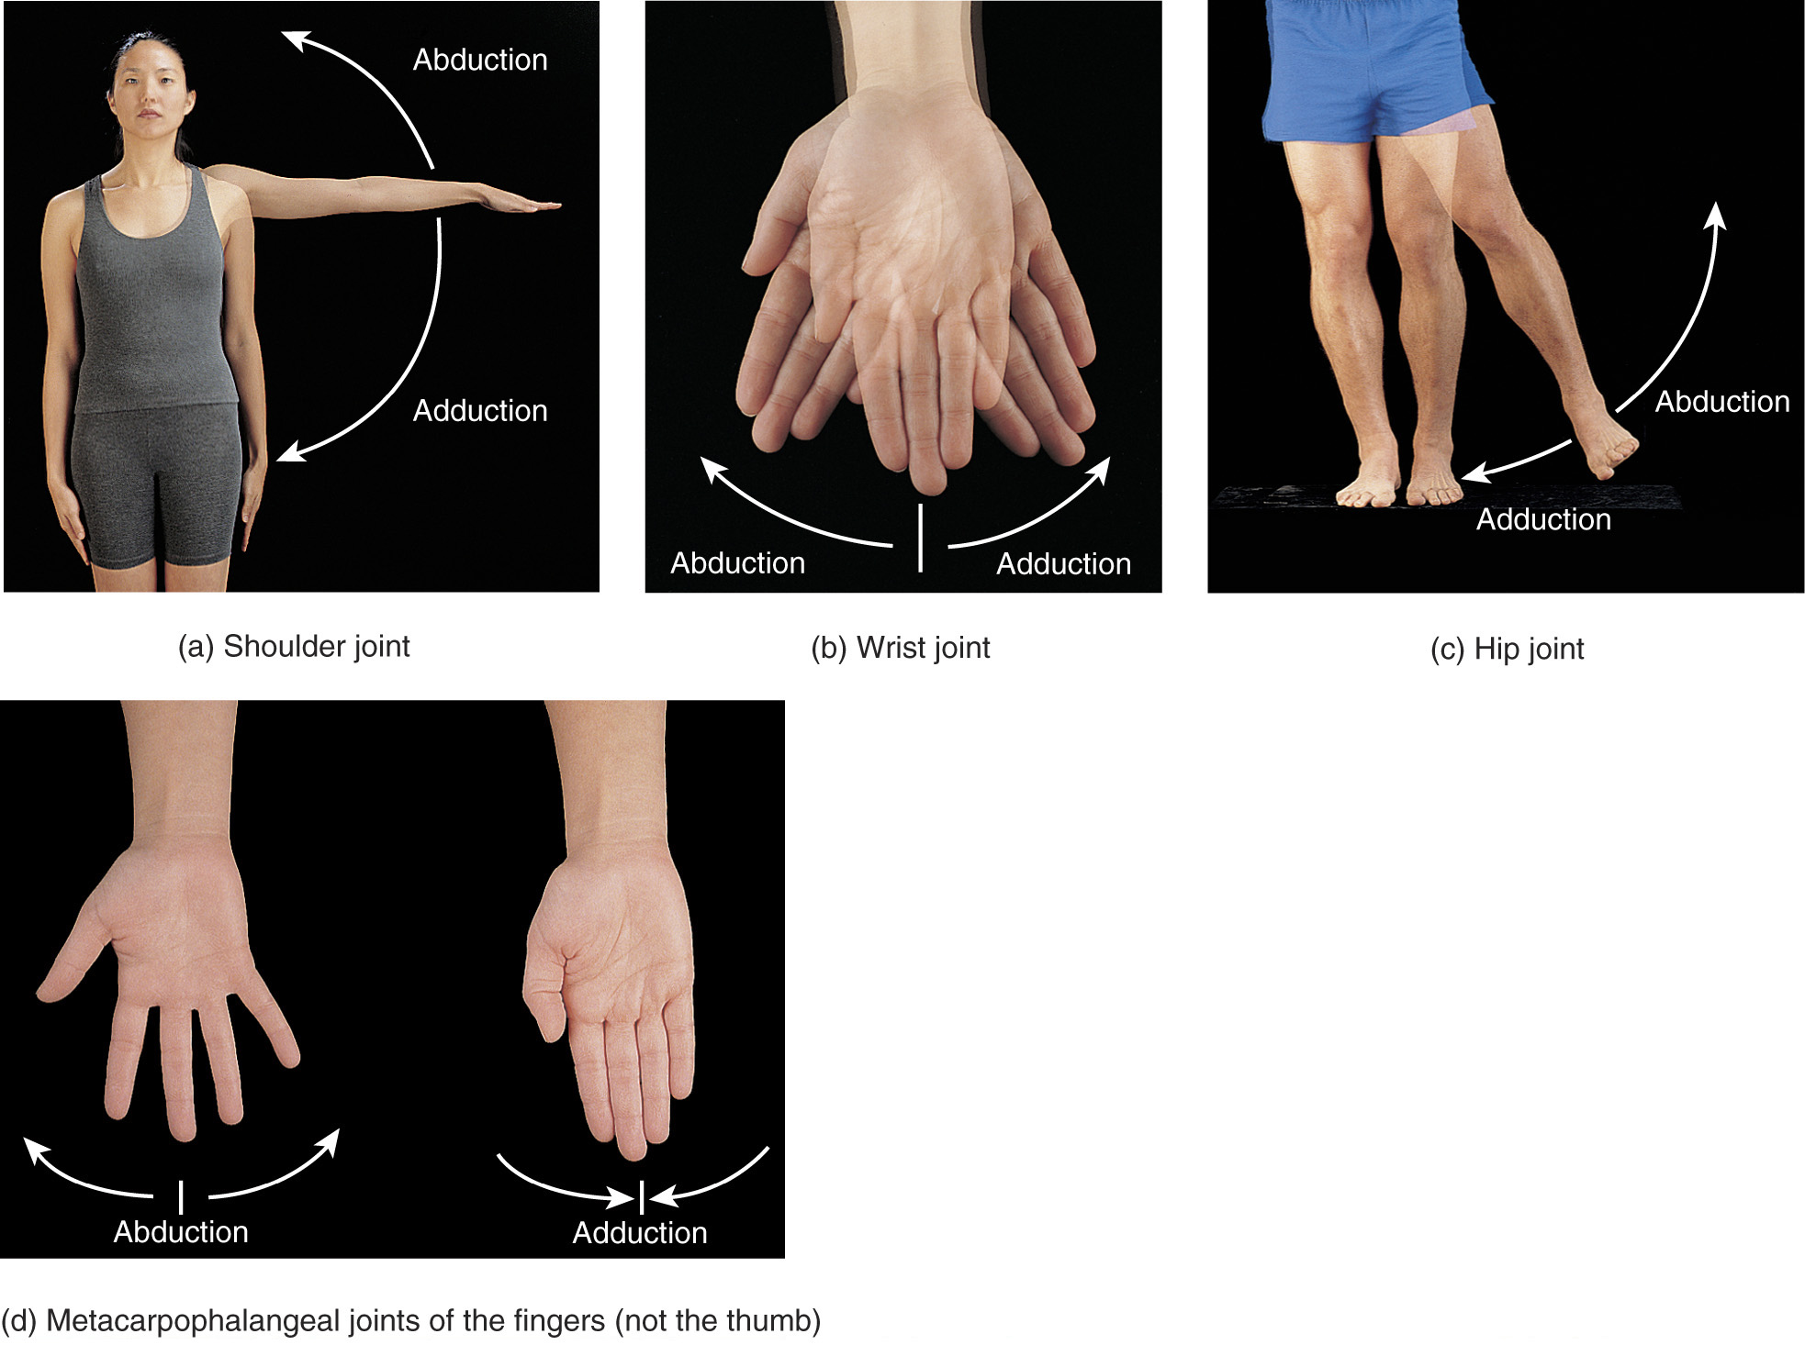

Slide 9
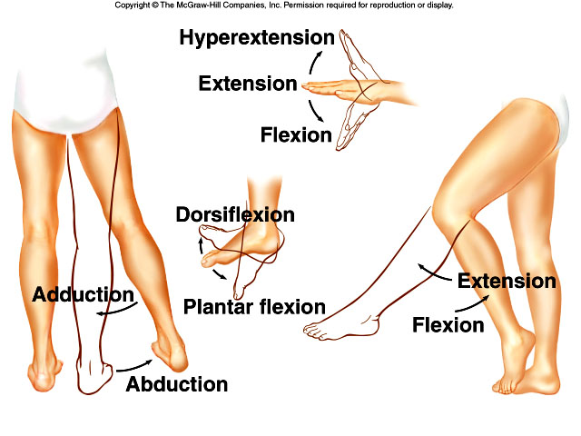

Slide 10
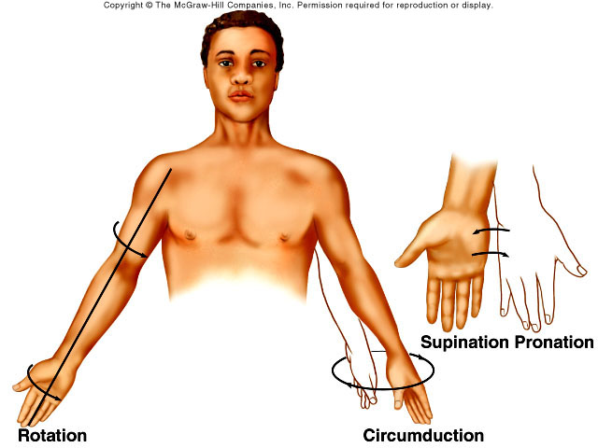
2. Circular Movements
Notes:
10
10

Slide 11
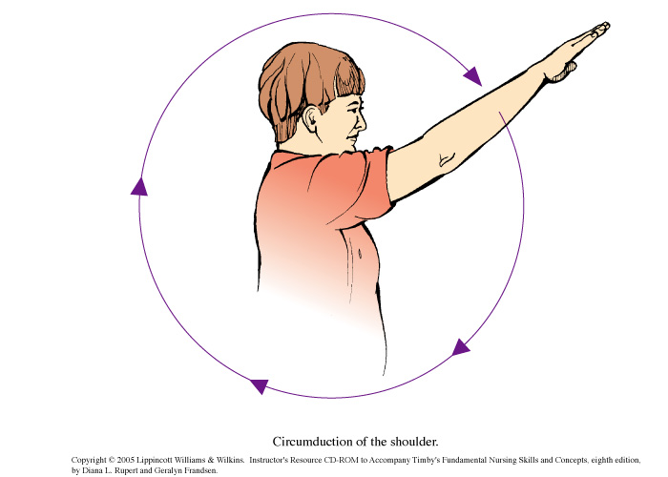
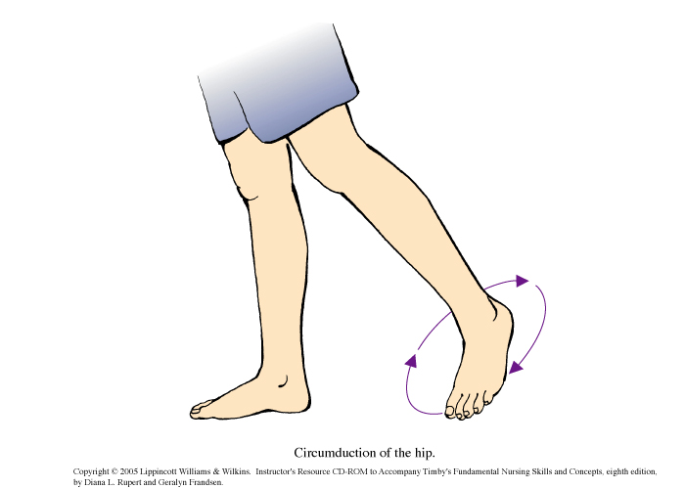
* circumduction : wide circle (shoulder/hip)
circumduction of the shoulder
circumduction of the hip
Notes:
11
11

Slide 12
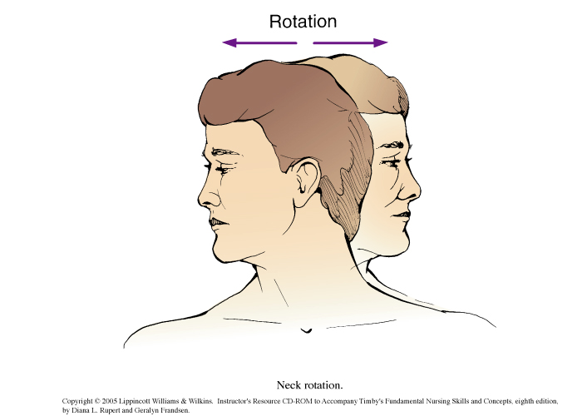
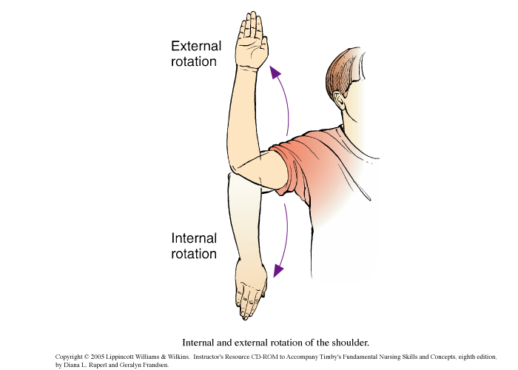
* rotation : body part around own axis
lateral/external = to the outside
medial/internal = to the inside
head
humerus
Notes:
12
12

Slide 14
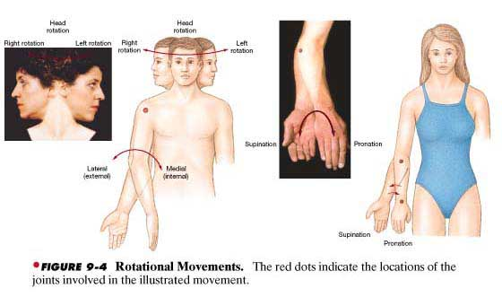
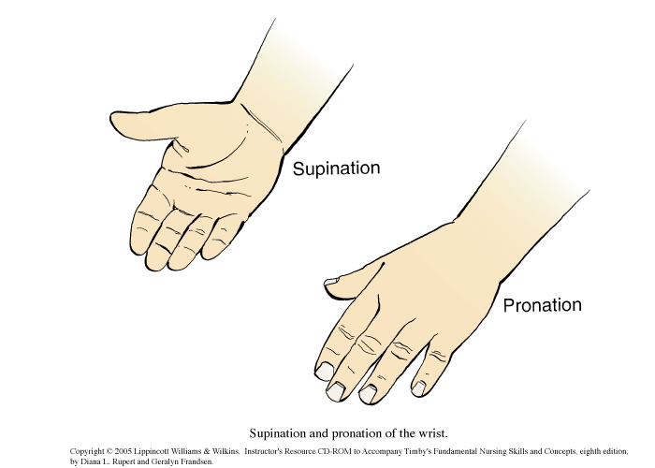
* pronation : palm downward/backward (forearm)
* supination : palm upward/forward (forearm)
Notes:
14
14

Slide 16
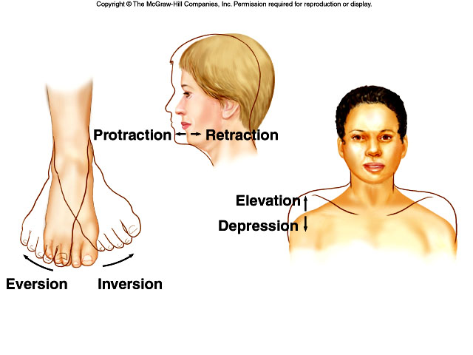
3. Special Movements
Notes:
16
16

Slide 17
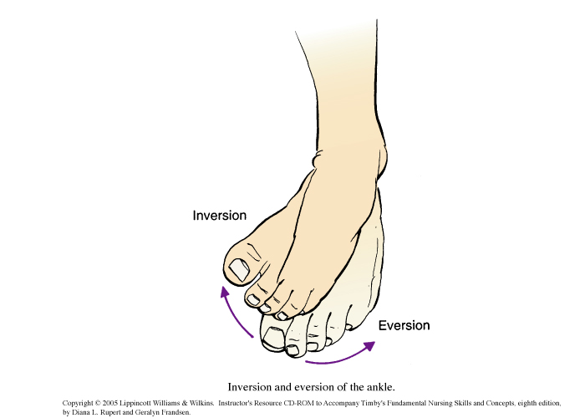
* inversion : foot sole inward
* eversion : foot sole outward
Notes:
17
17

Slide 19
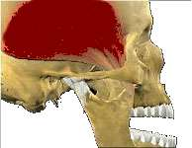
* elevation : lifting up (jaw/scapula)
* depression : pulling down (jaw/scapula)
Notes:
19
19

