Slide 1
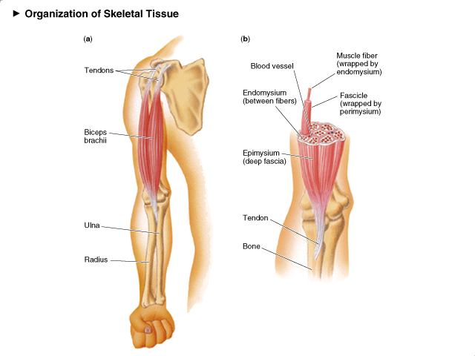
A. Anatomy of a
Skeletal Muscle

Slide 3
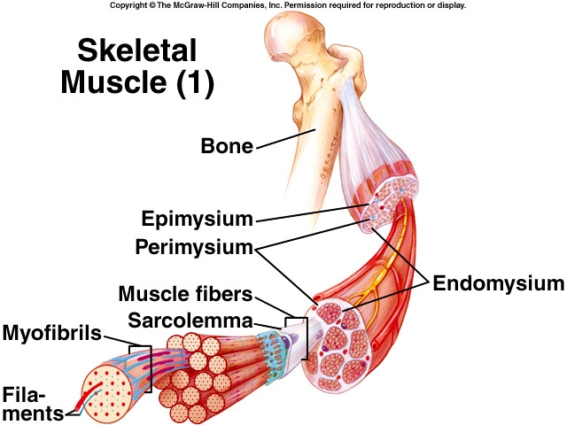
1. Connective Tissue Coverings
* organize fibers within a muscle:

Slide 4
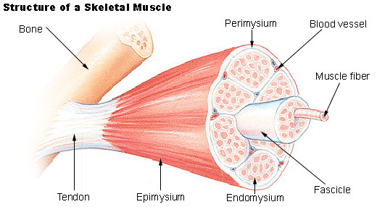
endomysium - surrounds individual muscle fibers
Notes:
4

Slide 5
perimysium – surrounds bundle of muscle
fibers fascicle

Slide 6
epimysium - surrounds entire muscle
fascia tendon bone

Slide 7
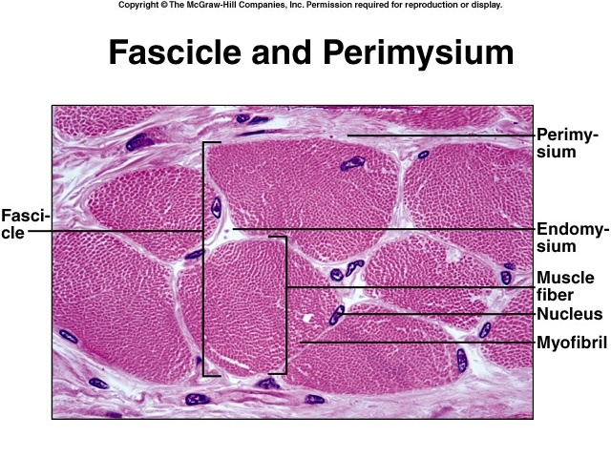

Slide 10
B. Functions of Skeletal Muscles
1. produce movement
2. maintain posture = support
3. generate heat = constant body temp
4. keep fluid moving in cardiovascular
and lymphatic vessels
5. protect internal organs, stabilize joints

Slide 12
