Slide 1
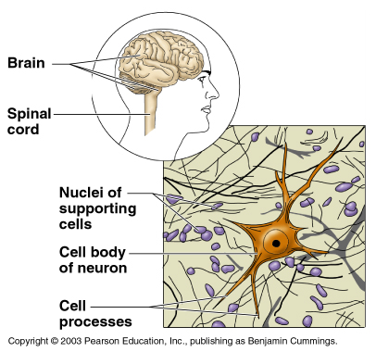
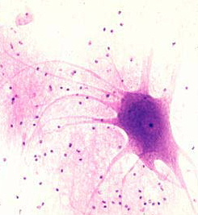
4.4 Nervous Tissue
* L: brain, spinal cord, nerves
* F: transmit information

Slide 2
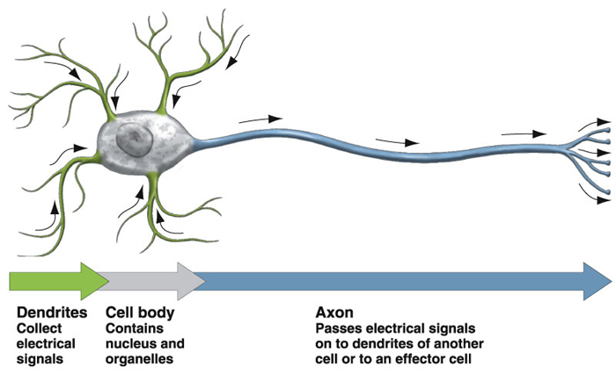
A. Neurons
* conduct nerve (electrical) impulses
* 3 parts:
dendrites – short, collect signals
cell body – main part, contains nucleus
axon – long, passes on nerve impulses

Slide 3
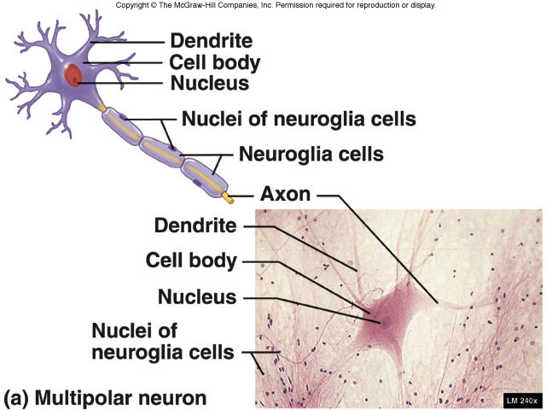
B. Neuroglia (glial cells)
* do not conduct nerve impulses
* support, protect, and nourish neurons

Slide 4
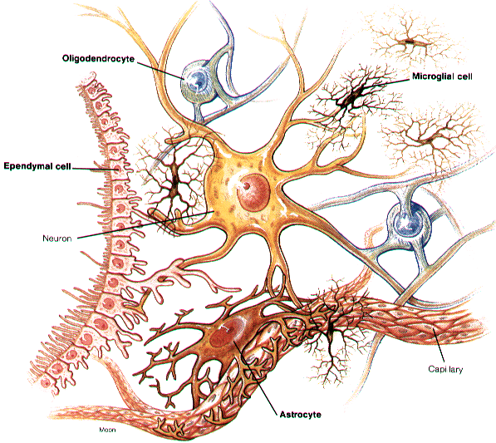
inside brain:
microglia – support neurons, engulf bacteria
astrocytes – provide nutrients to neurons
oligodendrocytes – form myelin (insulation)

Slide 5
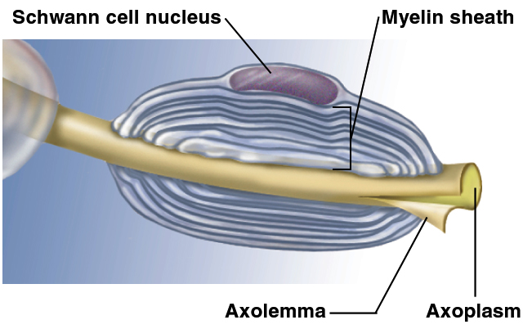
* outside brain/spinal cord:
Schwann cells - surround long axons
gaps between cells = nodes of Ranvier
produce myelin sheath (covering)
Node h of Ranvier

Slide 6
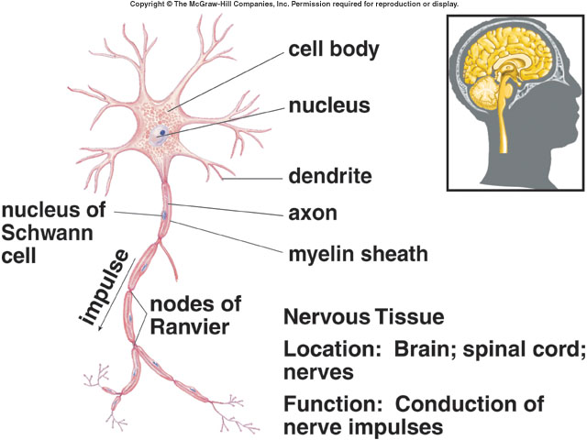

Slide 7
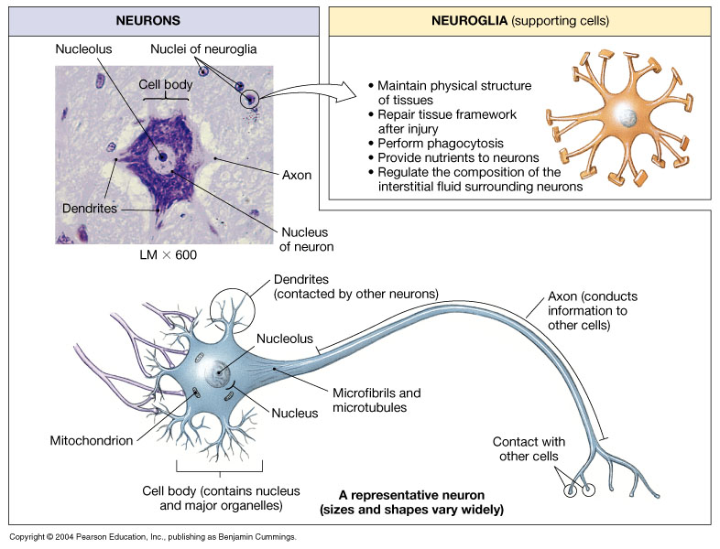

Slide 8
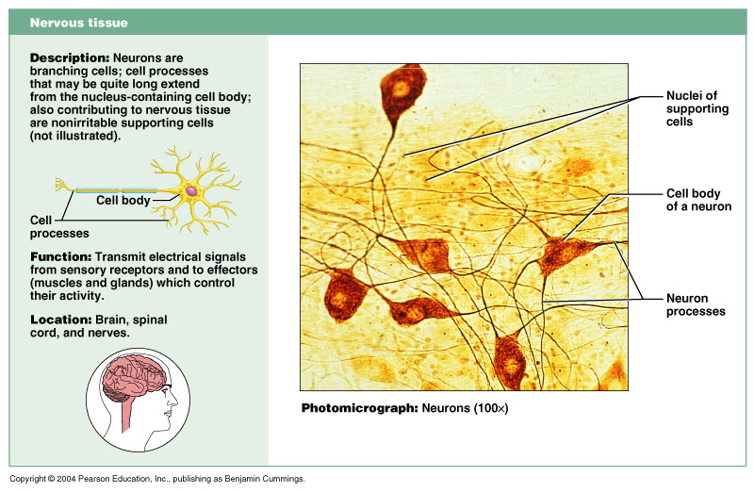

Slide 10
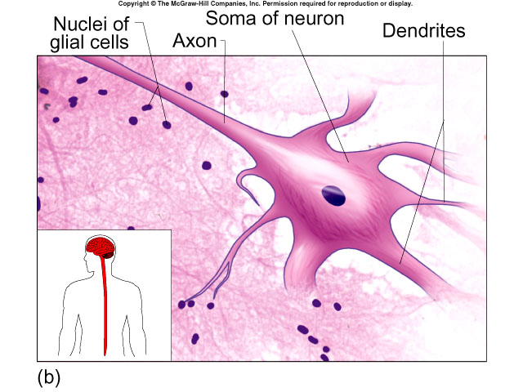

Slide 11
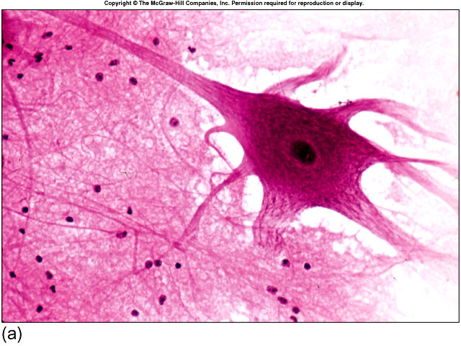

Slide 12
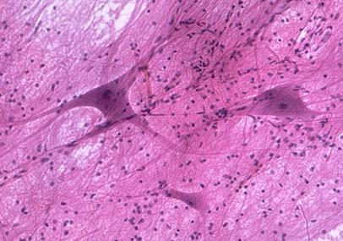

Slide 13
