Slide 1
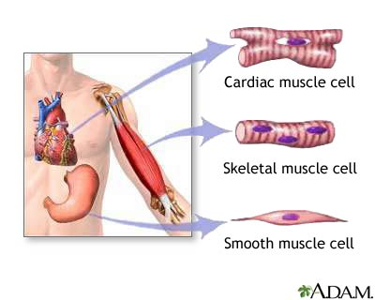
4.3 Muscular Tissue
* composed of cells called muscle fibers
* specialized for contraction

Slide 2
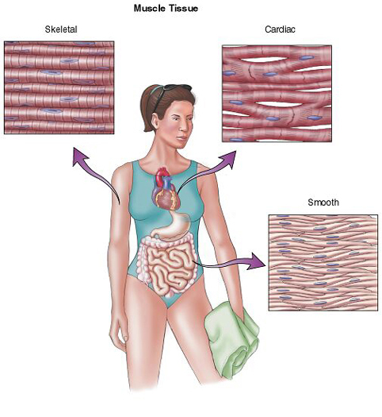

Slide 3
* 3 types:

Slide 4
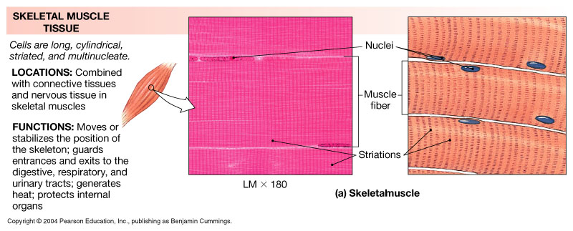
A. Skeletal Muscle
* D: striated, cylindrical, multinucleated
* L: skeletal muscles (attached to bones)
* F: voluntary, moves body parts

Slide 5
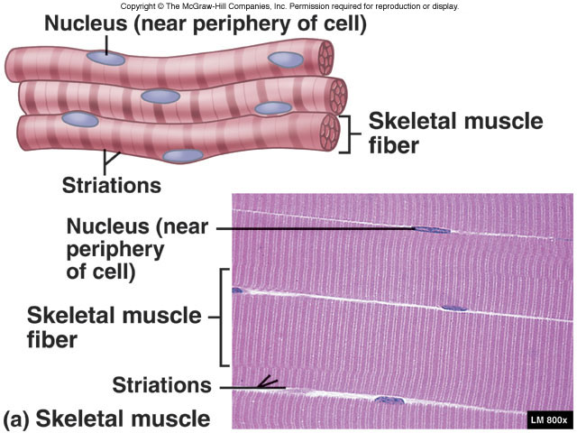

Slide 7
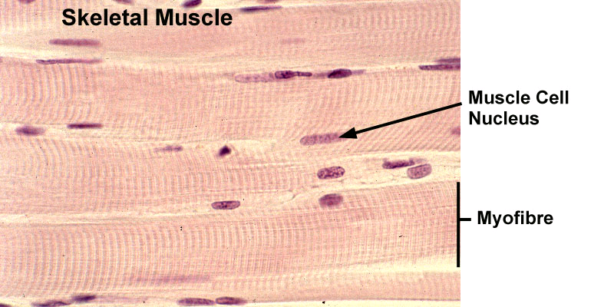

Slide 8
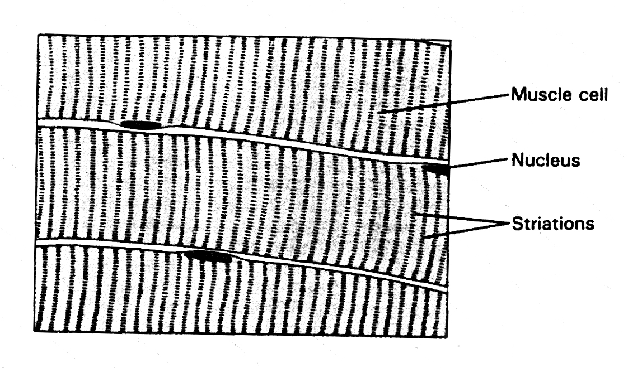

Slide 10
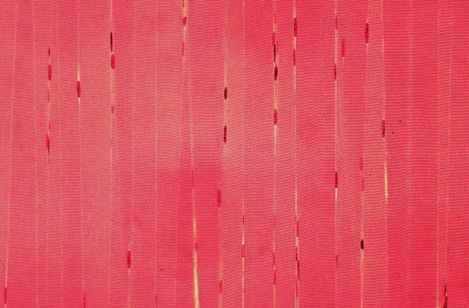

Slide 11
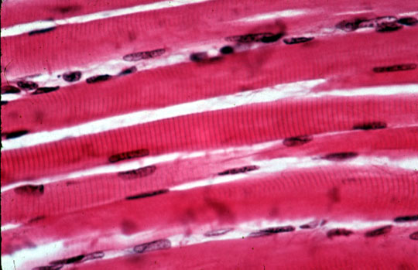

Slide 12
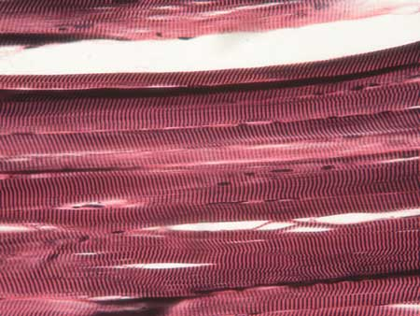

Slide 13
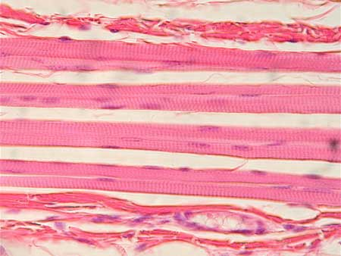

Slide 14
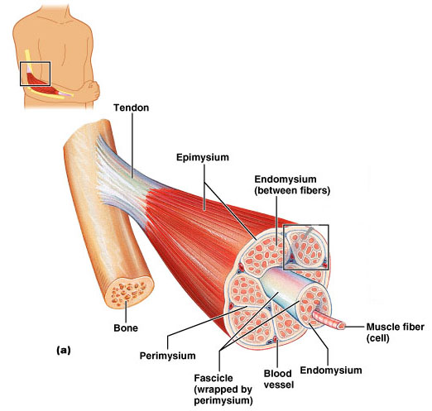

Slide 15
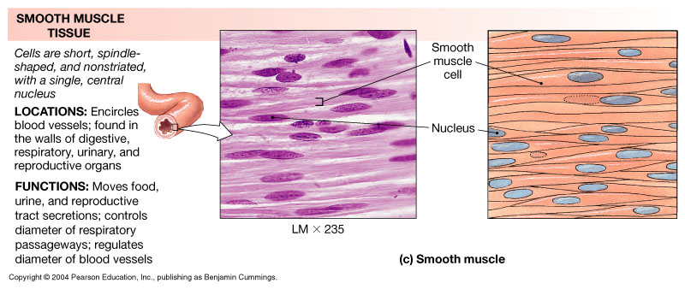
B. Smooth Muscle
* D: no striations, spindle shaped, one nucleus
* L: walls of hollow organs, blood vessels
* F: involuntary, moves substances
(slow, wavelike contractions)

Slide 17
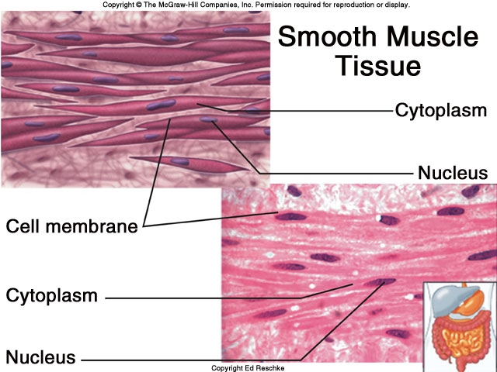

Slide 18
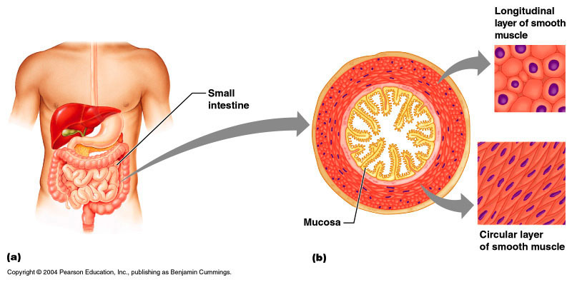

Slide 19
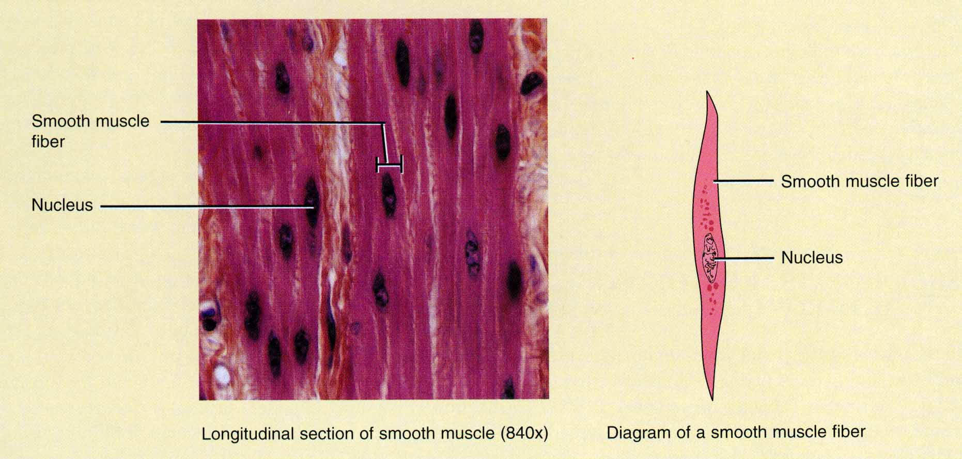

Slide 20
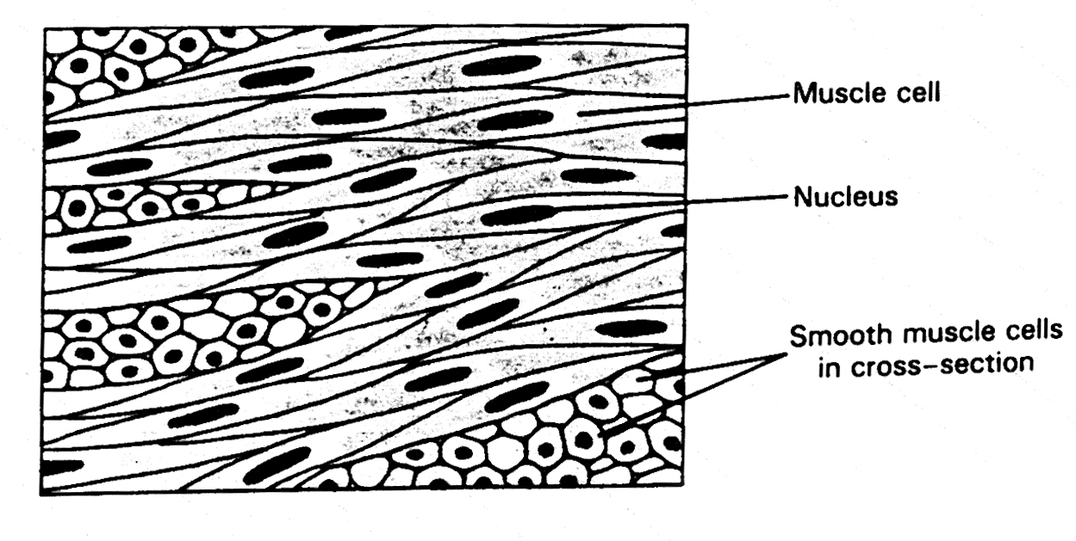

Slide 21
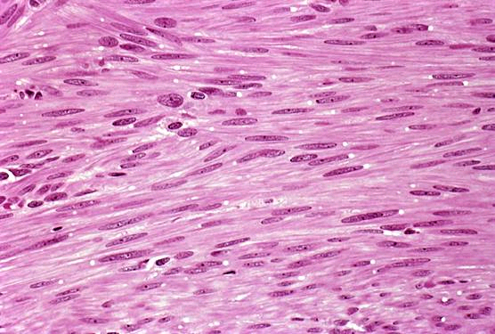

Slide 23
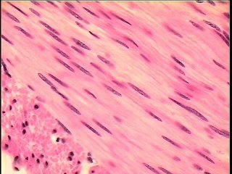

Slide 24
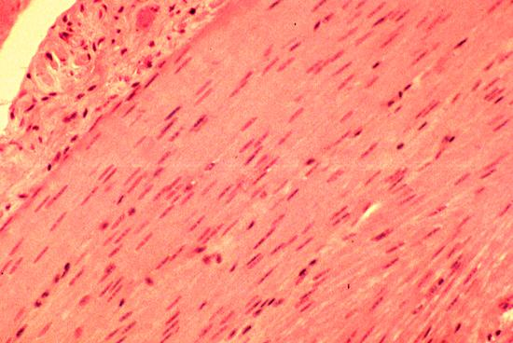

Slide 25
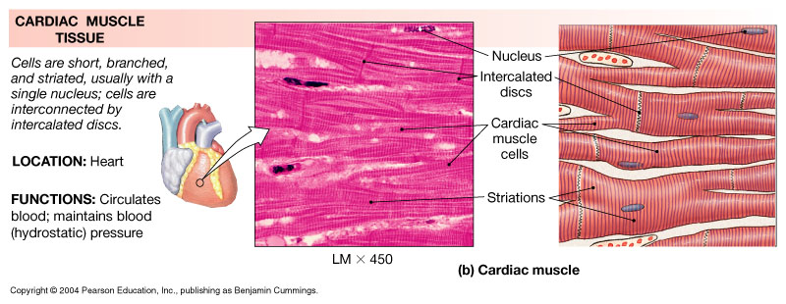
C. Cardiac Muscle
* D: striated, branched, one nucleus
between cardiac cells = intercalated disc
* L: heart
* F: involuntary, pumps blood

Slide 27
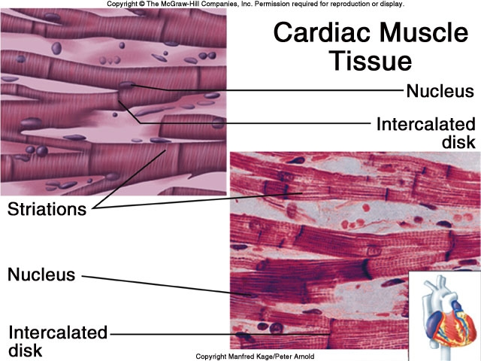

Slide 29
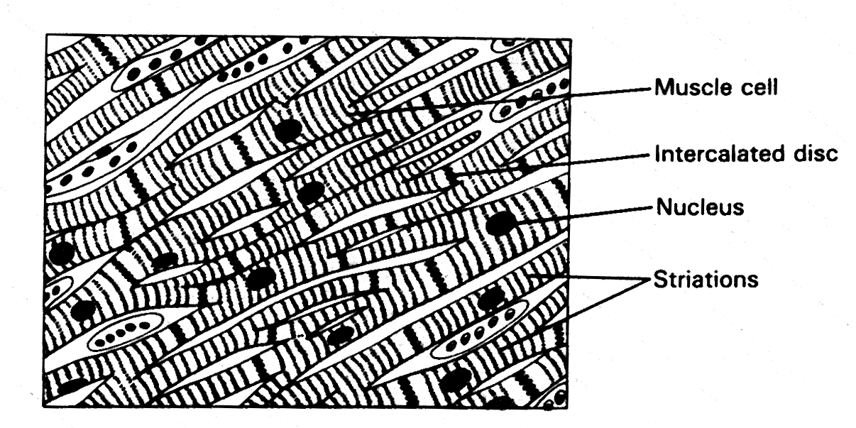

Slide 31
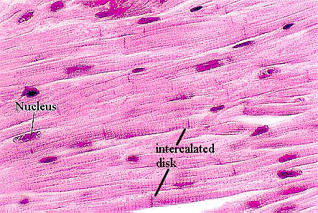

Slide 32
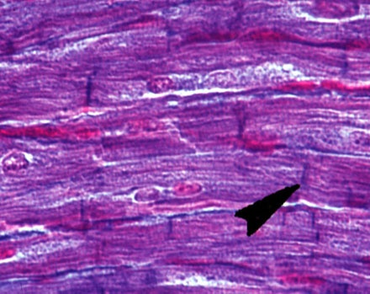

Slide 33
