Slide 2
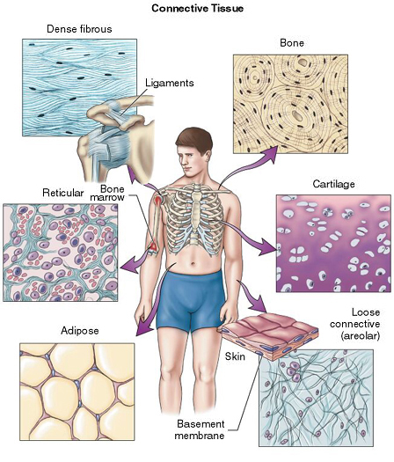
4.2 Connective Tissue
* most abundant and widely distributed tissue
Notes:
2

Slide 3
* functions:
binds structures together
supports and protects
fills spaces
produces blood cells
stores energy
provides immunity
Notes:
3

Slide 4
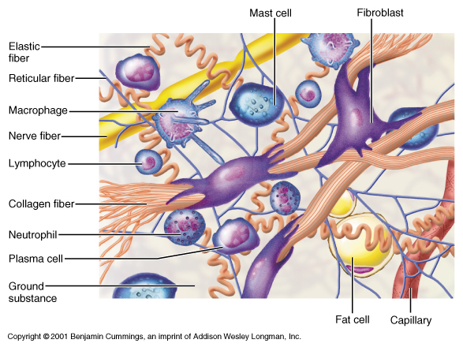
* matrix = nonliving material surrounding cells
(fibers, fluid, etc.)
Notes:
4

Slide 5
* 4 main classes:
fibrous, cartilage, bone, blood
Notes:
5

Slide 6
A. Fibrous Connective Tissue
* cells = fibroblasts
* 3 types of fibers: collagen, elastic, reticular

Slide 7
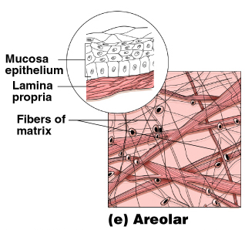
1. loose connective tissue
* fibers arranged in loose open framework

Slide 8
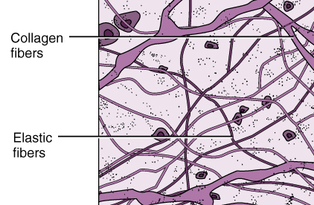
a. areolar
* between other tissues/organs

Slide 9
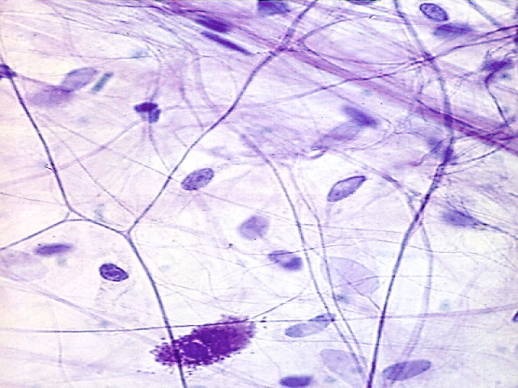

Slide 11
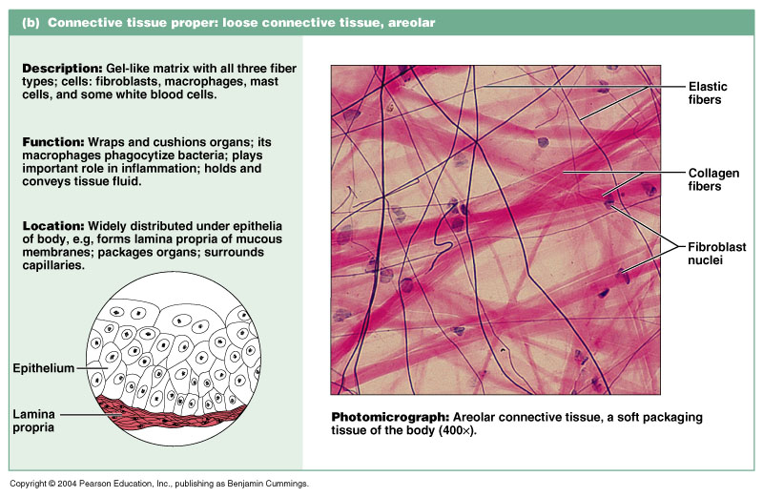
Fibrous Connective Tissue: Loose

Slide 12
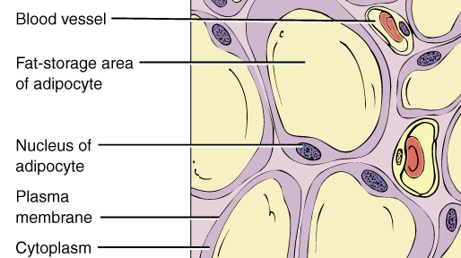
b. adipose
* insulation, protection, energy storage (fat)

Slide 13
Connective Tissue Proper: Loose

Slide 14
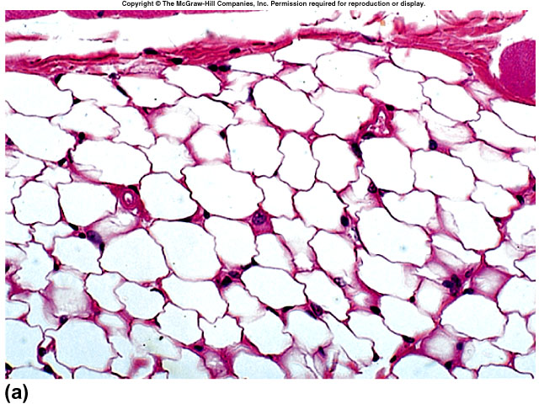

Slide 16
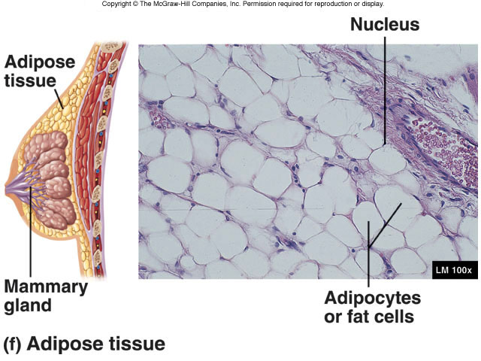

Slide 17
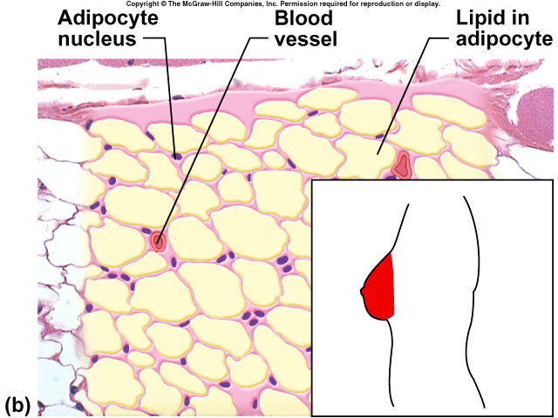

Slide 18
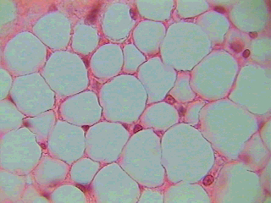

Slide 19
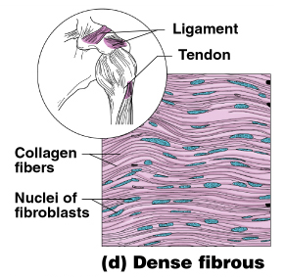
2. dense connective tissue
* contains many collagen fibers packed together

Slide 20
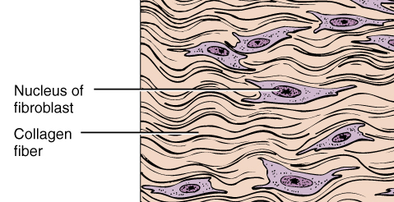
a. dense regular
* bundles of fibers are parallel
* tendons (M B) ligaments (B B)

Slide 21
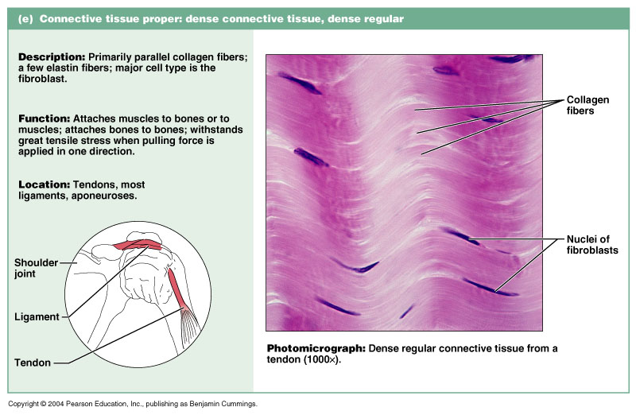
Fibrous Connective Tissue: Dense Regular

Slide 22
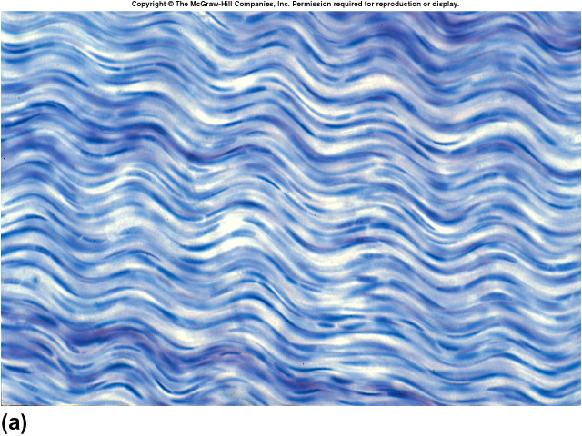

Slide 23
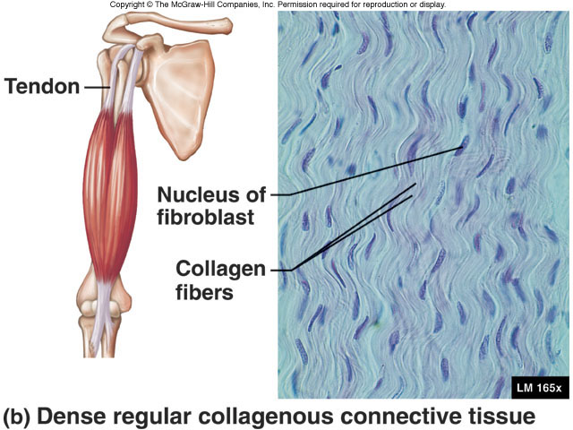

Slide 24
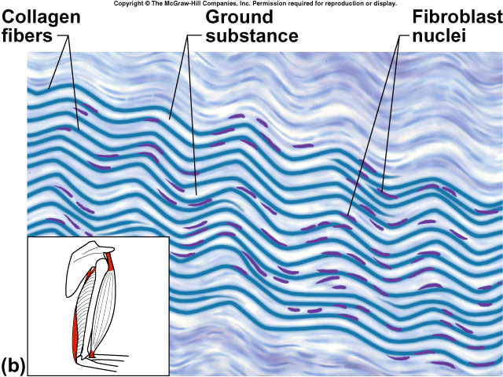

Slide 25
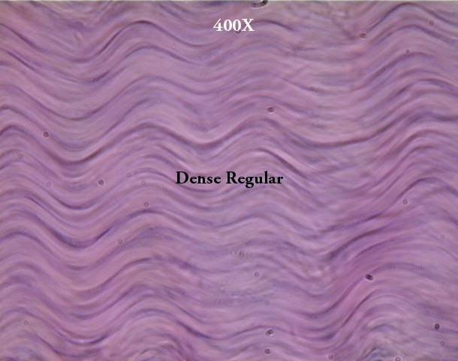

Slide 27
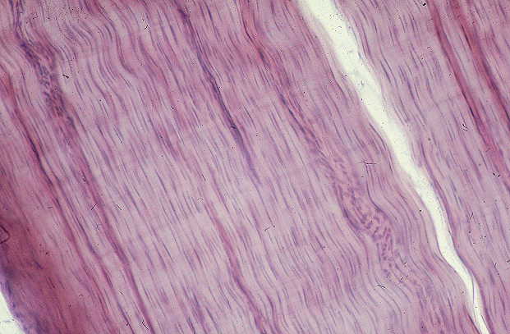

Slide 28
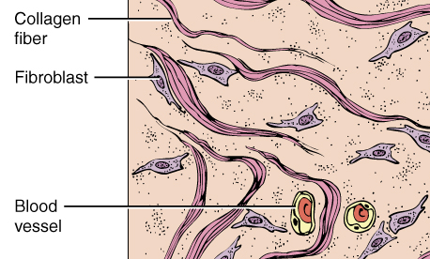
b. dense irregular
* bundles of fibers run in different directions
* inner layer of skin (dermis)

Slide 30
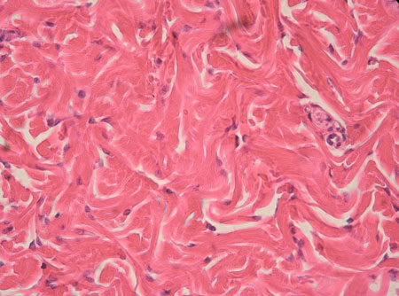

Slide 31
3. reticular connective tissue
* also called lymphatic tissue
* reticular fibers and WBC’s
* lymph nodes, spleen, thymus, bone marrow

Slide 32
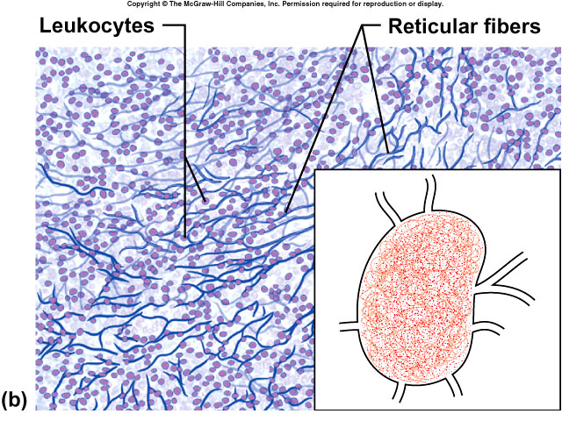

Slide 33
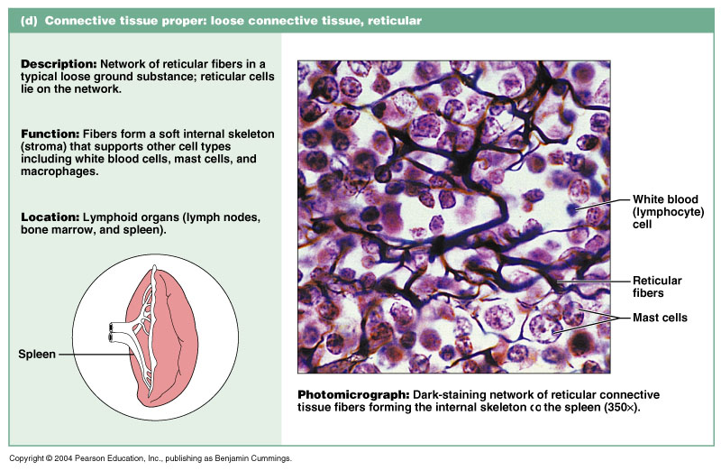
Fibrous Connective Tissue: Reticular

Slide 34
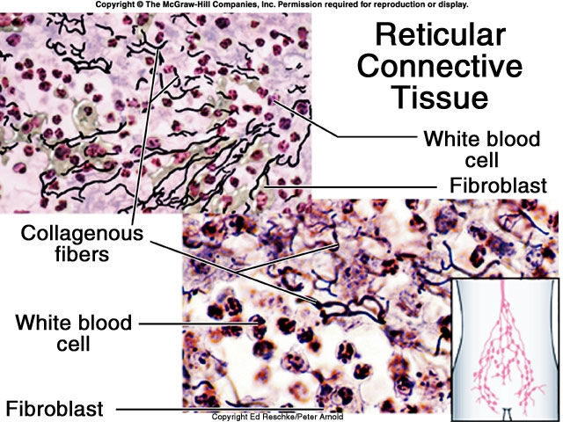

Slide 35
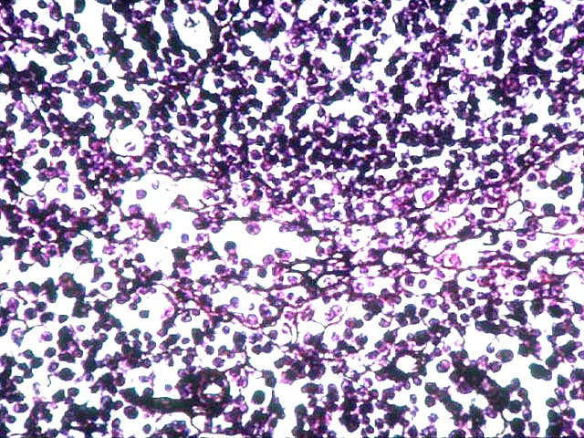
Reticular Tissue

Slide 36
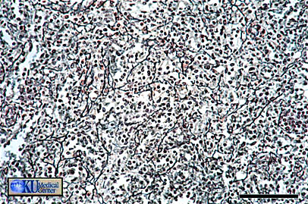
Reticular Tissue

Slide 37
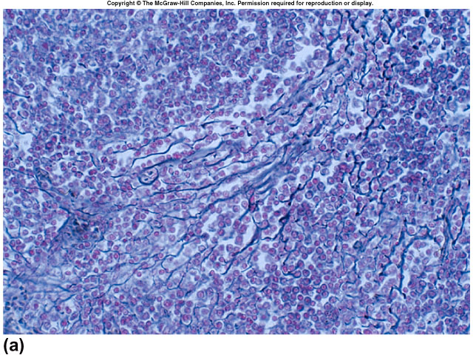

Slide 38
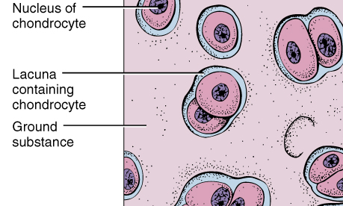
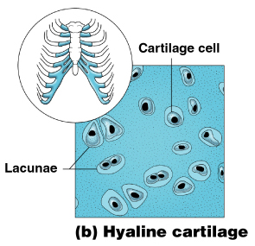
B. Cartilage
* cells = chondrocytes
(lie in small chambers called lacunae)
* protein matrix , solid but flexible

Slide 39
1. hyaline cartilage
* most common
* ends of long bones,
rib cage, nose, trachea (windpipe)

Slide 40
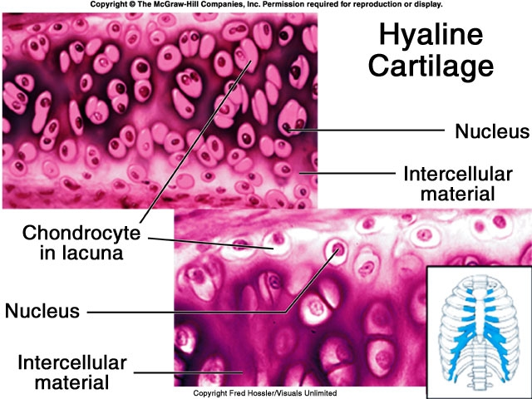
Notes:
40

Slide 41
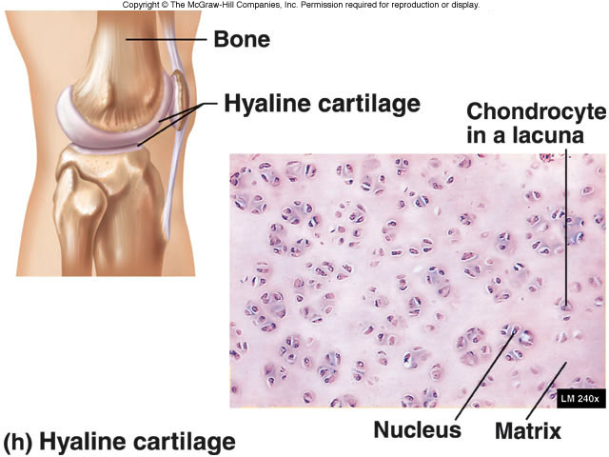
Notes:
41

Slide 42
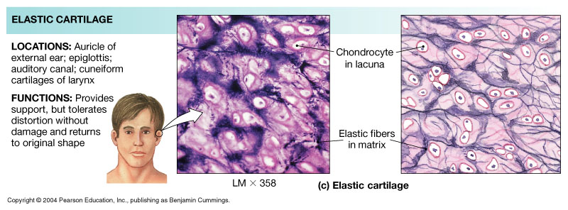
2. elastic cartilage
* contains elastic fibers in matrix = flexible
* outer ear, epiglottis

Slide 44
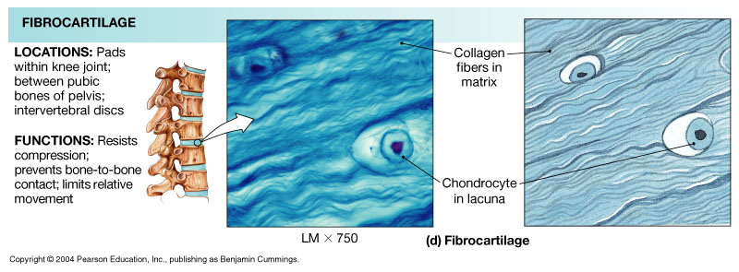
3. fibrocartilage
* collagen fibers in matrix = strongest
* between vertebrae, knee joint

Slide 46
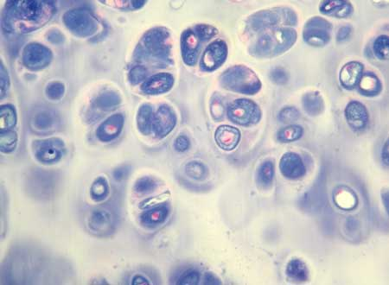
#9

Slide 48
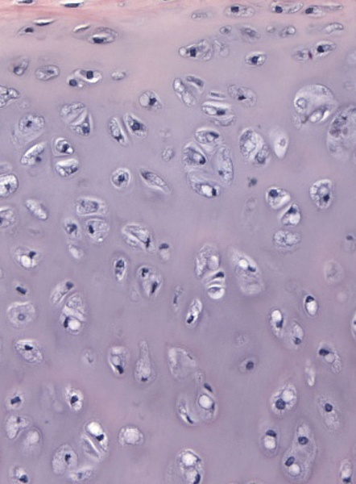

Slide 49
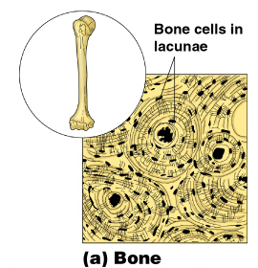
C. Bone (osseous tissue)
* cells = osteocytes
* hard mineral matrix around protein fibers

Slide 51
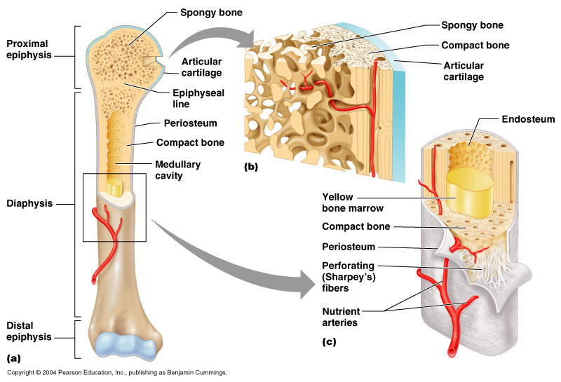

Slide 52
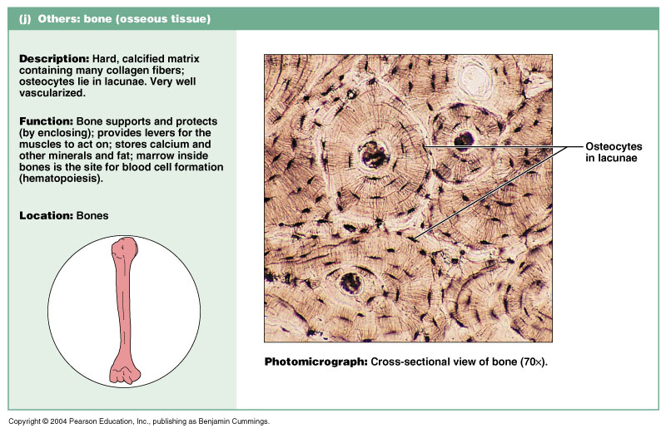
1. compact bone
* outer portion of bones
* consists of many cylindrical units (osteons)

Slide 53
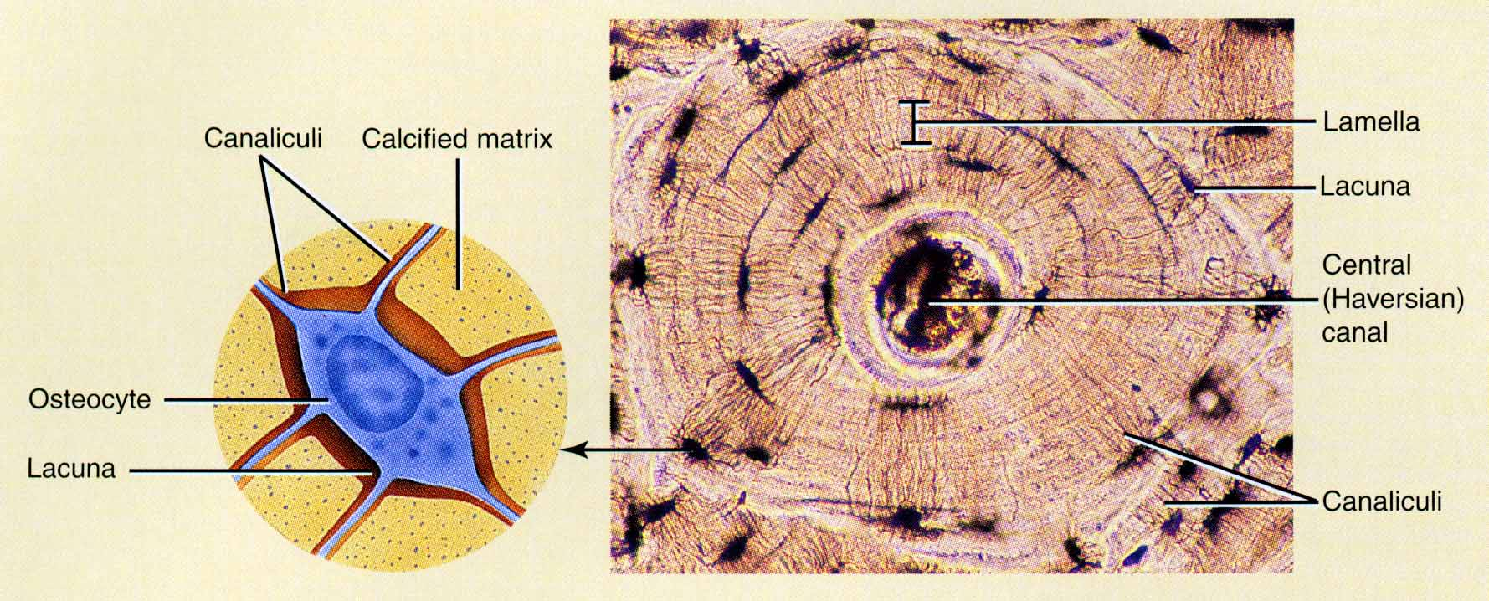

Slide 54
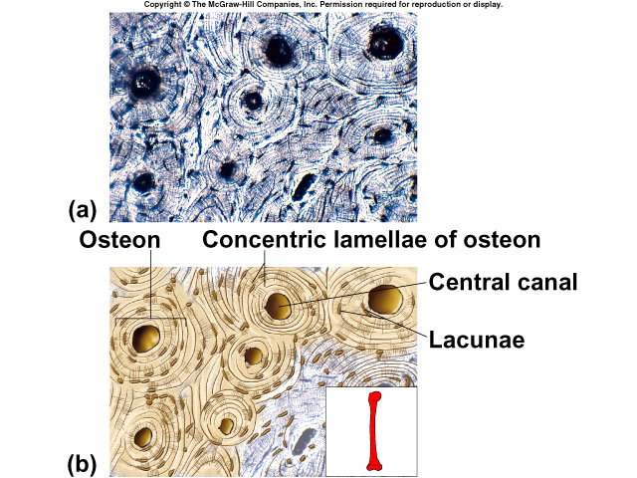

Slide 55
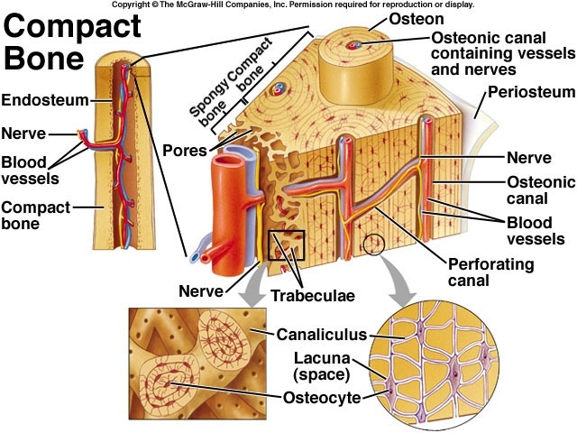

Slide 56
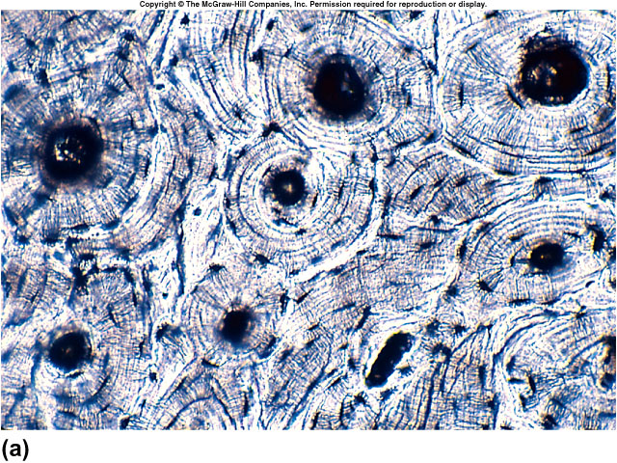

Slide 57
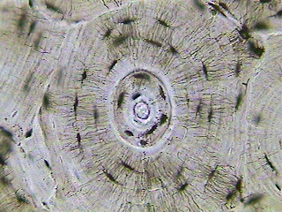

Slide 58
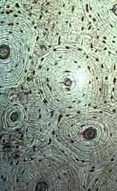

Slide 59
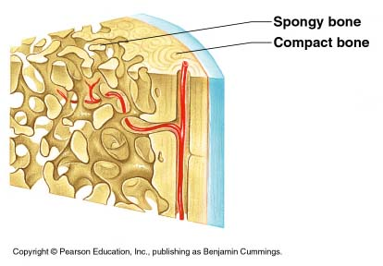
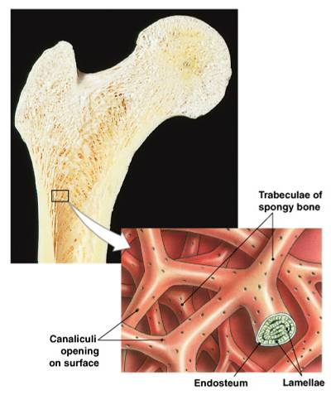
2. spongy bone
* ends of long bones
* bony plates (trabeculae), irregular spaces
* blood cell formation (red marrow)

Slide 60
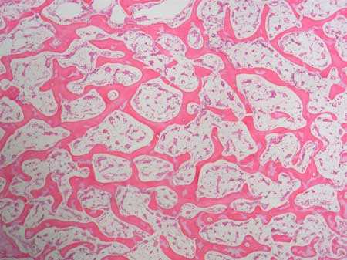

Slide 61
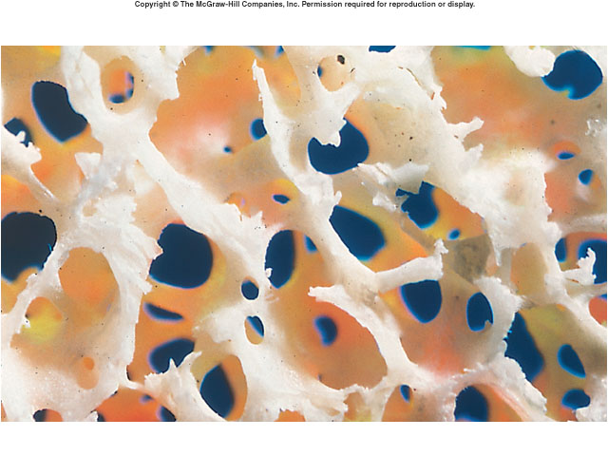

Slide 63
D. Blood

Slide 64
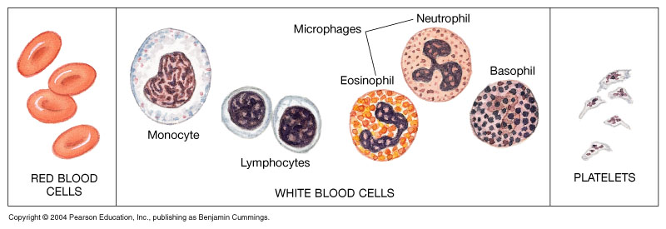
* cells = formed elements
red blood cells (erythrocytes) – carry O₂
white blood cells (leukocytes) – fight infection
platelets (thrombocytes) – clotting

Slide 65
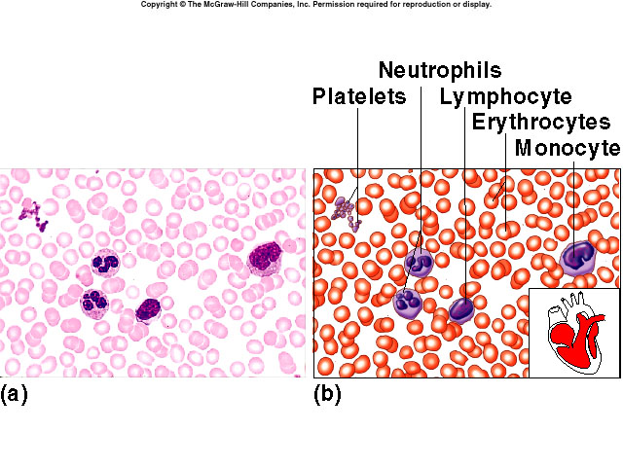

Slide 67
* liquid matrix = plasma

Slide 68
Connective Tissue: Blood

